Slide 1
‘What’s the worst fire alarm application that you have ever seen?’ judges: Drew turner, joel reitz, john maitrejean, & toby woods
CAFAA 50TH ANNUAL CONFERNCE

Slide 2
ENTRY # 01

Slide 3
ENTRY # 02

Slide 4
ENTRY # 03

Slide 5
ENTRY # 04

Slide 6
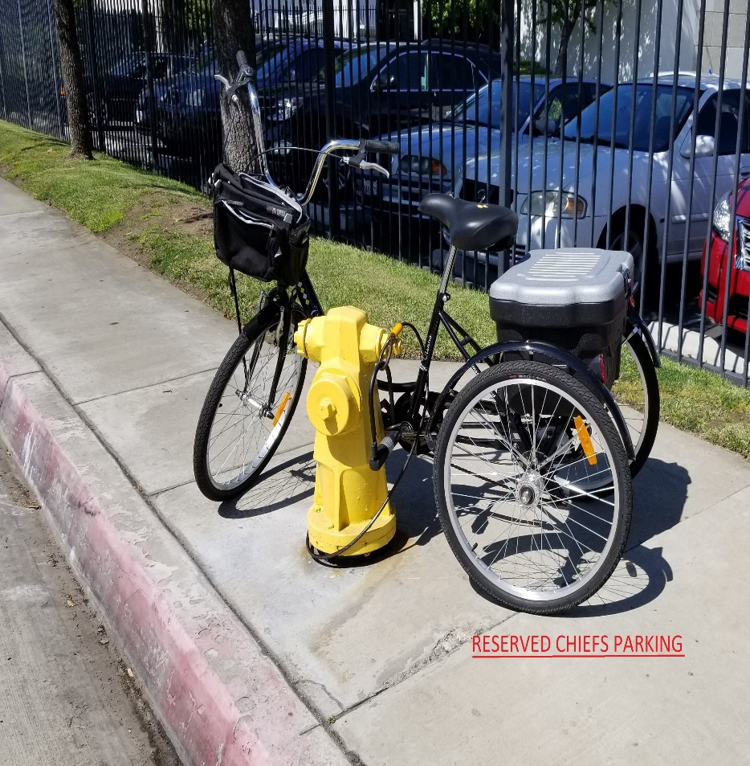
ENTRY # 05

Slide 7
ENTRY # 06

Slide 8
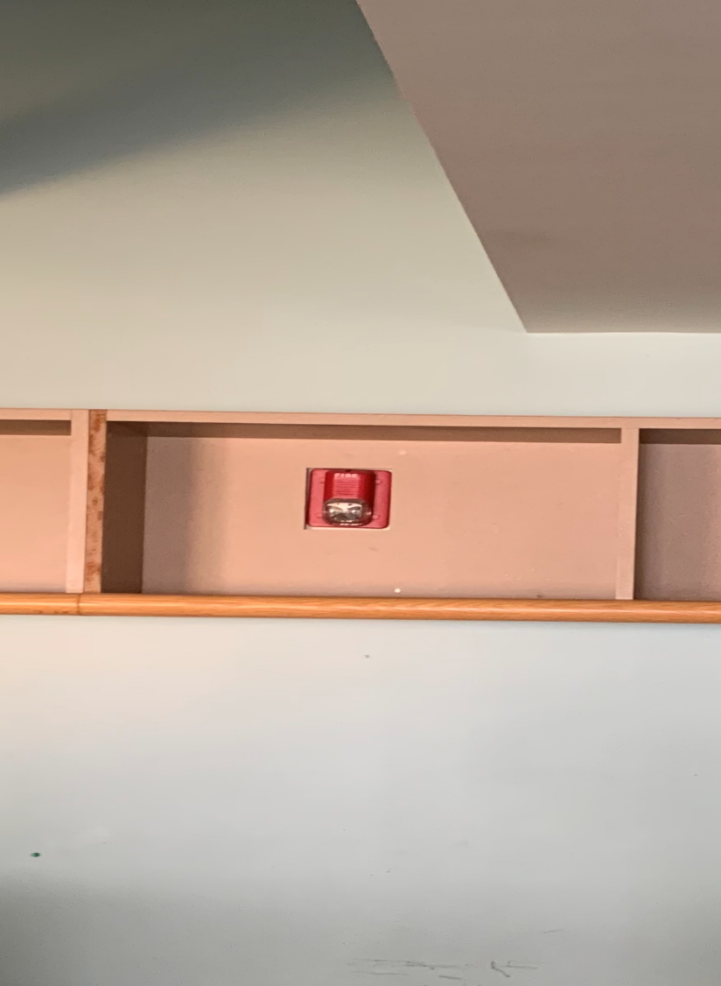
ENTRY # 07

Slide 9
ENTRY # 08

Slide 10
ENTRY # 09
NFPA 72 -2019 Chapter 18 (Not adopted in CA)
NEW !! UL Listed combination speaker/strobe/sprinkler device

Slide 11
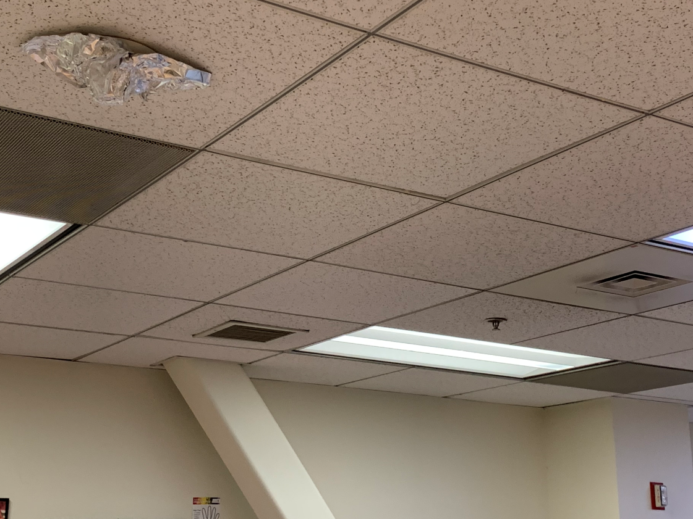
ENTRY # 10
NFPA 72 -2019 Chapter 17 (Not adopted in CA)
NEW !! UL Listed – Kitchen Smoke detection in Fully Sprinklered office Building + UL Listed aluminum covers within 12” of HVAC registers to avoid conflict with A.17.7.4.1
A.17.7.4.1 Detectors should not be located in a direct airflow or closer than 36 in. (910 mm) from an air supply diffuser or return air opening.

Slide 12
ENTRY # 11
Per NFPA 72 -2019 Chapter 10 – (Not adopted in CA)
FACU elevation at 7 feet to the display – Firefighters must also be NBA players
NFPA 72 -2019 Chapter 17 (Not adopted in CA)
NEW !! UL Listed – Kitchen Smoke detection in Fully Sprinklered office Building + UL Listed aluminum covers within 12” of HVAC registers to avoid conflict with A.17.7.4.1
A.17.7.4.1 Detectors should not be located in a direct airflow or closer than 36 in. (910 mm) from an air supply diffuser or return air opening.

Slide 13
ENTRY # 12

Slide 14
ENTRY # 13
Required Air-Condition system with UL listed Duct Tape
3005.2 Venting. Elevator machine rooms, machinery spaces that contain the driving machine, and control rooms or spaces that contain the operation or motion controller for elevator operation shall be provided with an independent ventilation or air-conditioning system to protect against the overheating
of the electrical equipment. The system shall be capable of maintaining temperatures within the range established for the elevator equipment.

Slide 15
ENTRY # 14

Slide 16
ENTRY # 15
FireLite Miniscan fire alarm panel with a brick placed at the reset button to keep it from going into alarm. Done by an alarm dealer. No name mentioned to protect the innocent!

Slide 17
ENTRY # 16
Melted Sauna Stobe

Slide 18
ENTRY #17
If the wires and module don’t fit, you must resubmit

Slide 19
ENTRY # 18
Hey, I think we may need another module

Slide 20
ENTRY # 19
Not so primary power supply

Slide 21
Entry #19 blown up

Slide 22
ENTRY # 20
What the ….? As you can see the FACU is still working, but in ‘Trouble’ (to say the least)’

Slide 23
ENTRY #21

Slide 24
ENTRY #22

Slide 25
ENTRY #23

Slide 26
ENTRY # 24

Slide 27
ENTRY # 25

Slide 28
ENTRY # 26

Slide 29
ENTRY # 27

Slide 30
ENTRY # 28

Slide 31
ENTRY # 29

Slide 32
ENTRY # 30

Slide 33
ENTRY # 31

Slide 34
ENTRY # 32

Slide 35
ENTRY # 33

Slide 36
Entry #34

Slide 37
Entry #35

Slide 38
NON-COMPETING ENTRY # 2

Slide 39
NON-COMPETING ENTRY # 3

Slide 40
NON-COMPETING ENTRY # 4

Slide 41
NON-COMPETING ENTRY # 5

Slide 42
NON-COMPETING PHOTO # 6

Slide 43
NON-COMPETING PHOTO # 07

Slide 44
NON-COMPETING PHOTO # 08

