Slide 1

‘What’s the worst fire alarm application that you have ever seen?’ judges: Drew turner, joel reitz, john maitrejean, john strohecker, & toby woods
CAFAA 49TH ANNUAL CONFERNCE

Slide 2
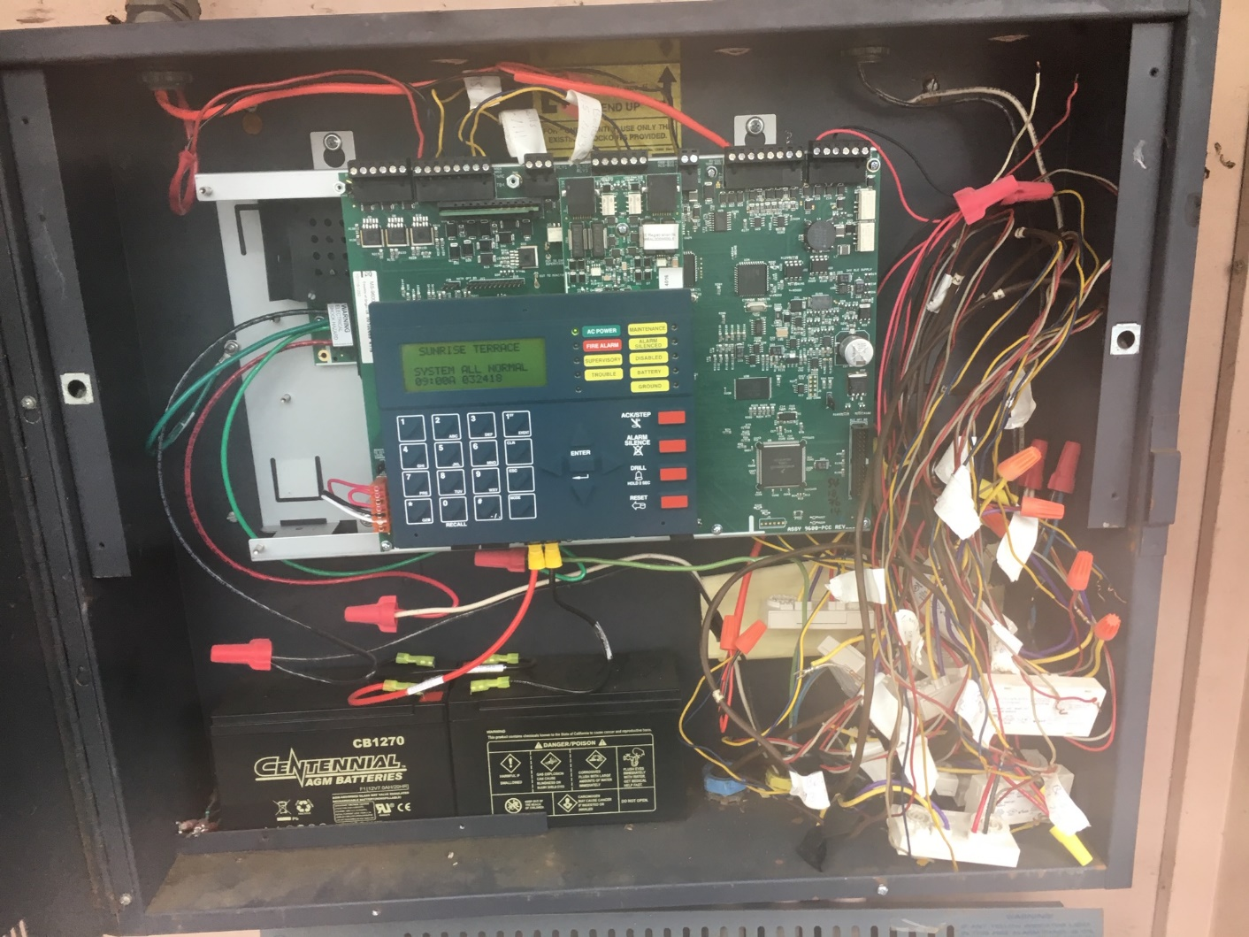
ENTRY # 1-1

Slide 3
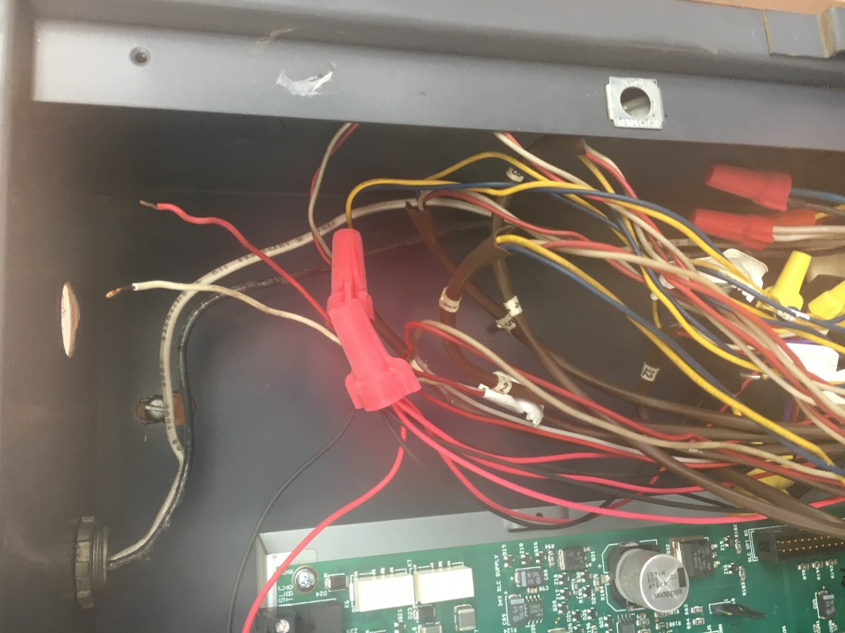
ENTRY # 1-2

Slide 4
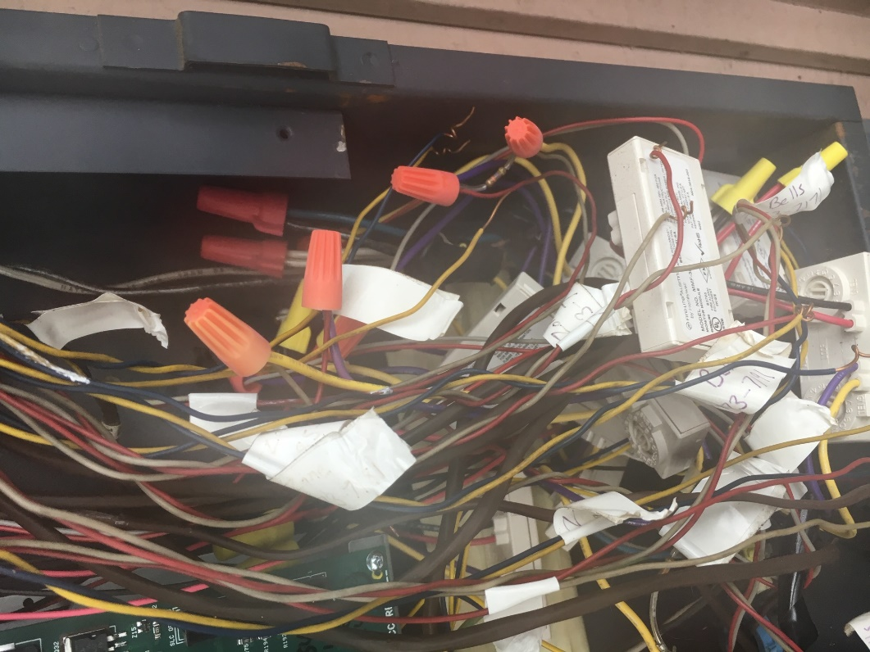
ENTRY # 1-3

Slide 5
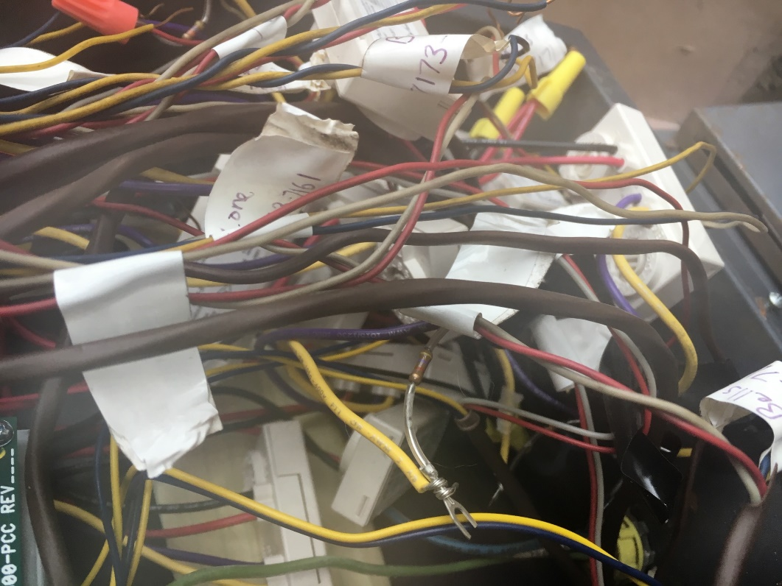
ENTRY # 1-4

Slide 6
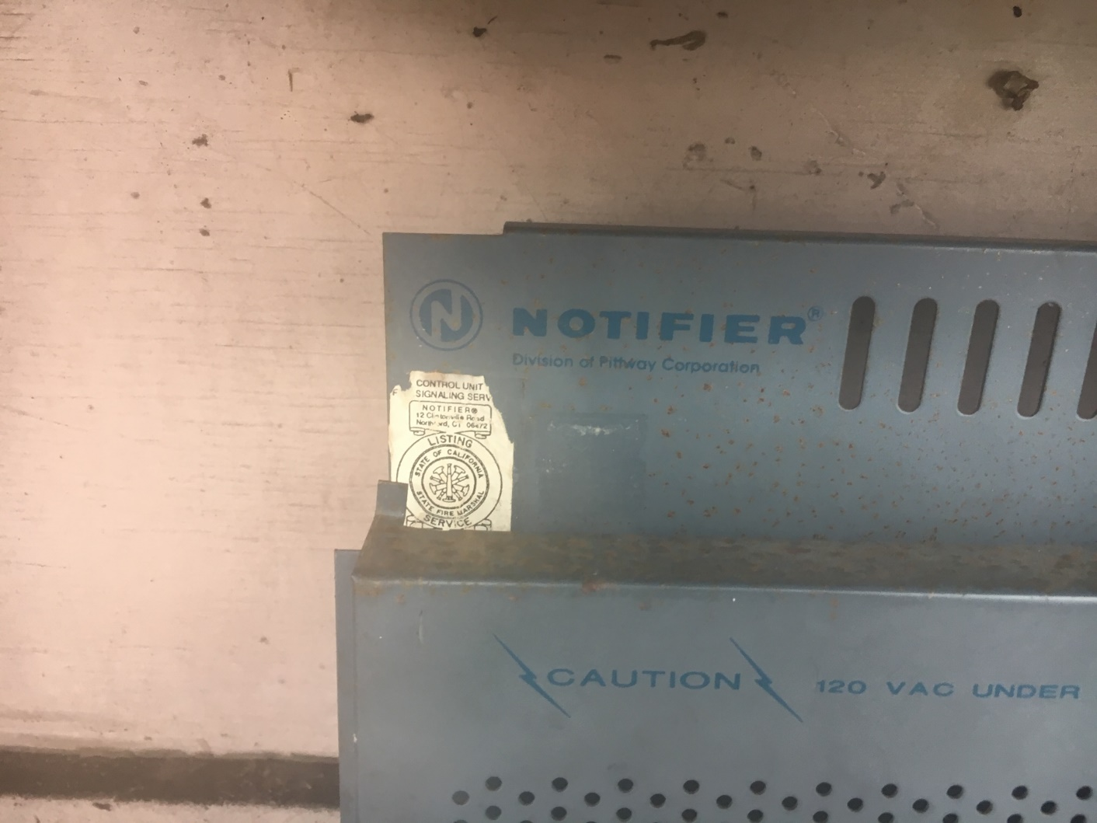
ENTRY # 1-5

Slide 7
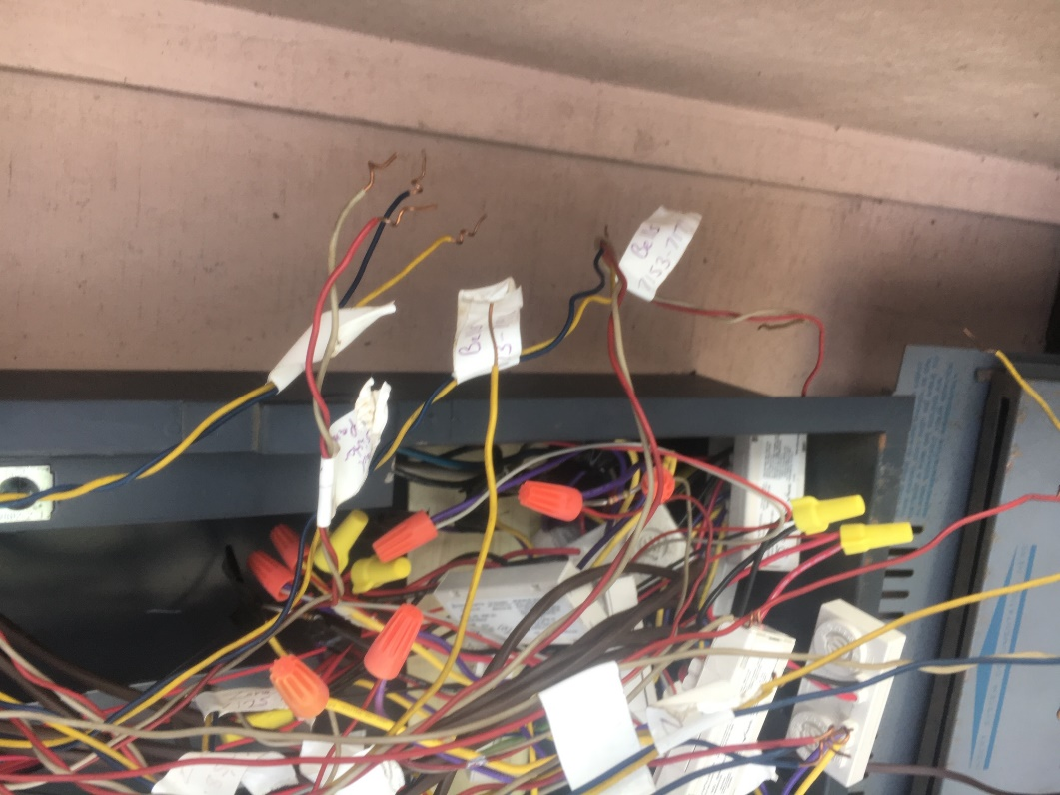
ENTRY # 1-6

Slide 8
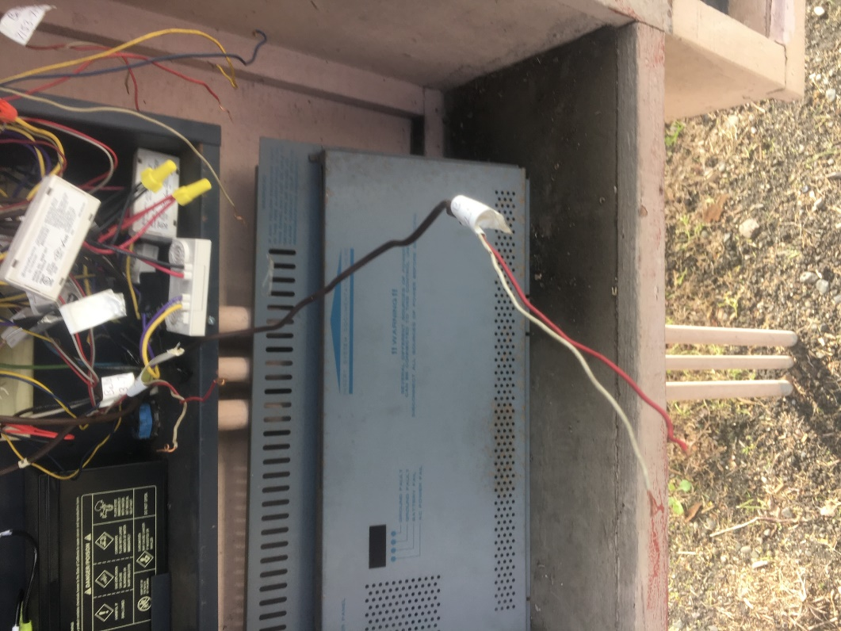
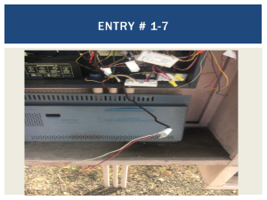
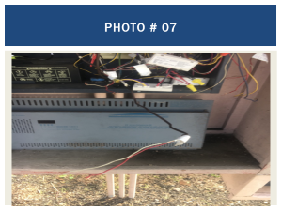
ENTRY # 1-7

Slide 9
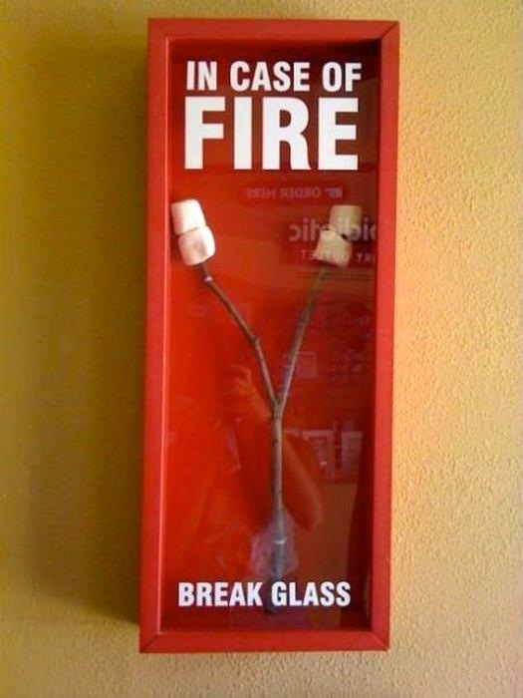
ENTRY # 2

Slide 10
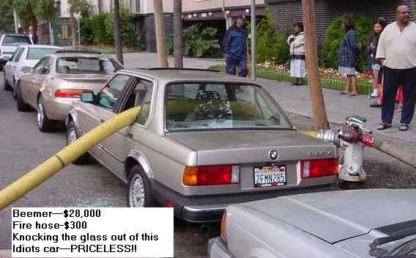
ENTRY # 3

Slide 11
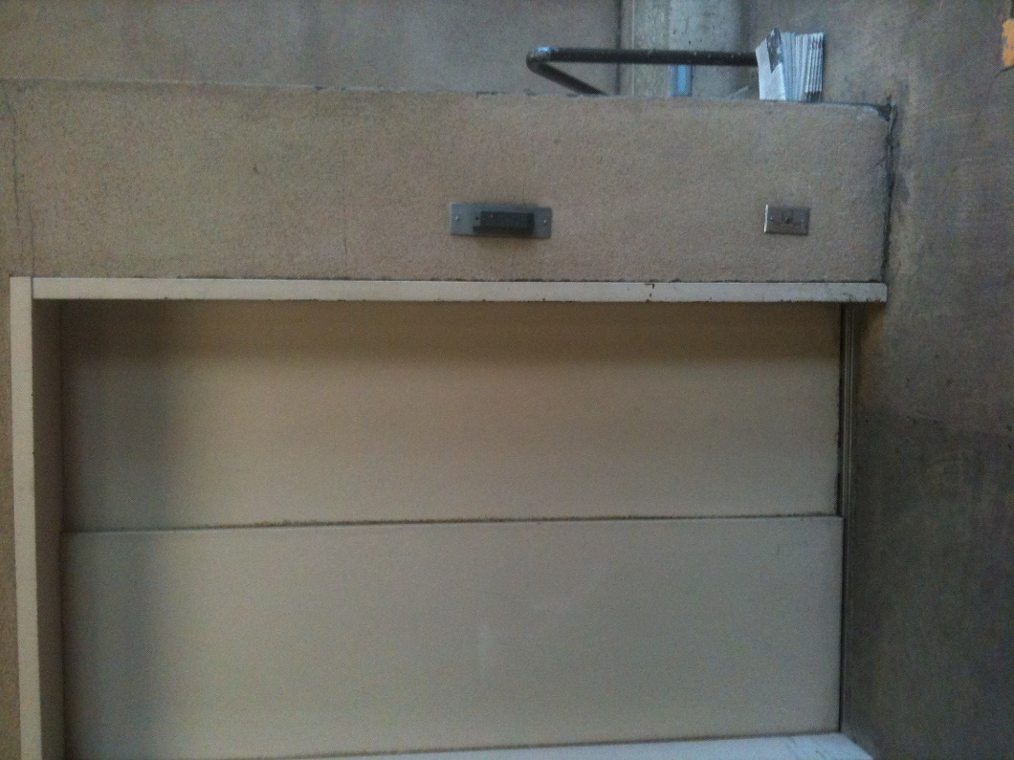
ENTRY # 4

Slide 12
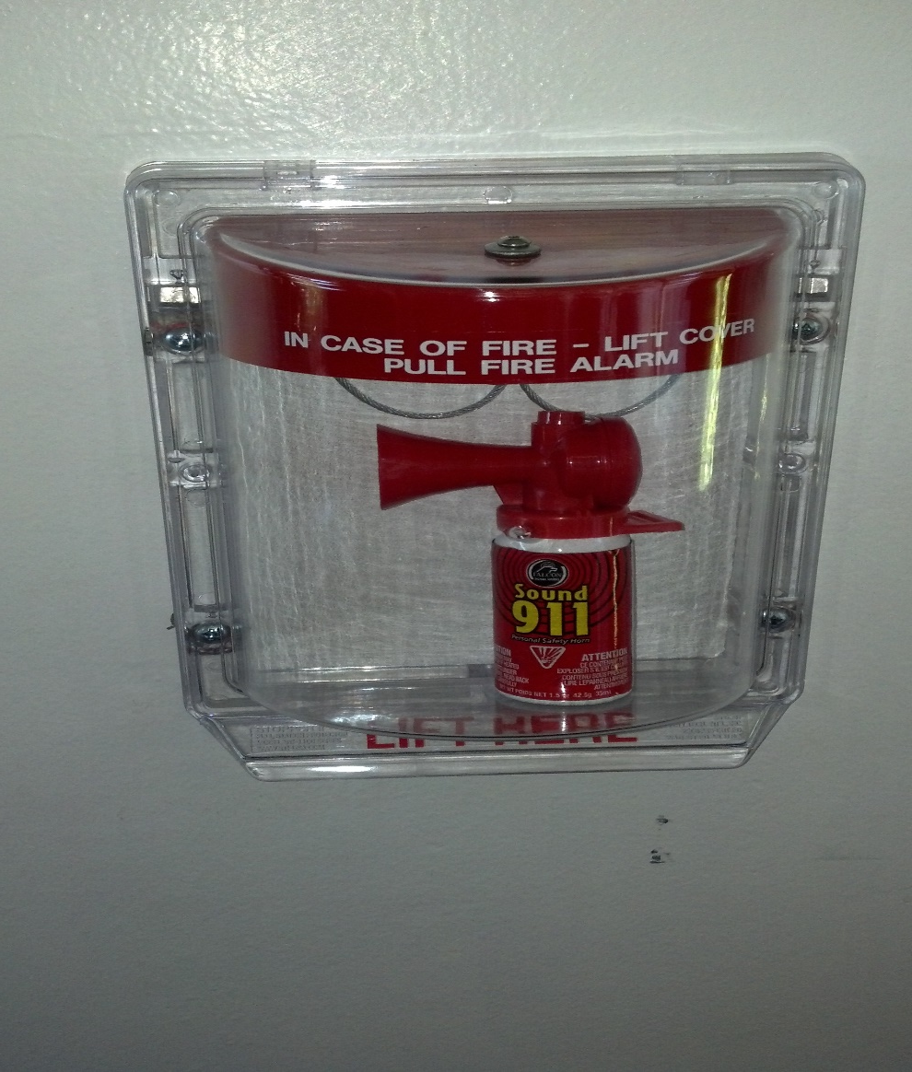
ENTRY # 5

Slide 13
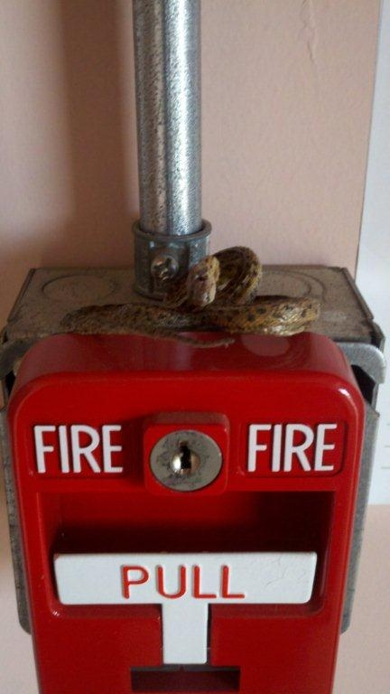
ENTRY # 6

Slide 14
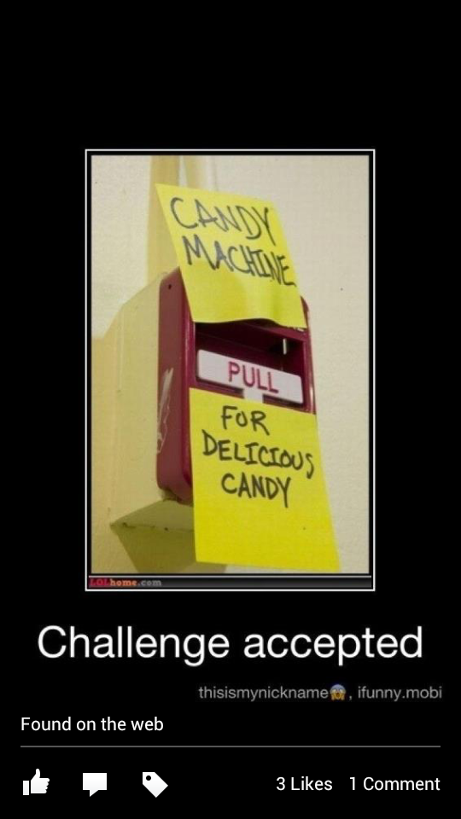
ENTRY # 7

Slide 15
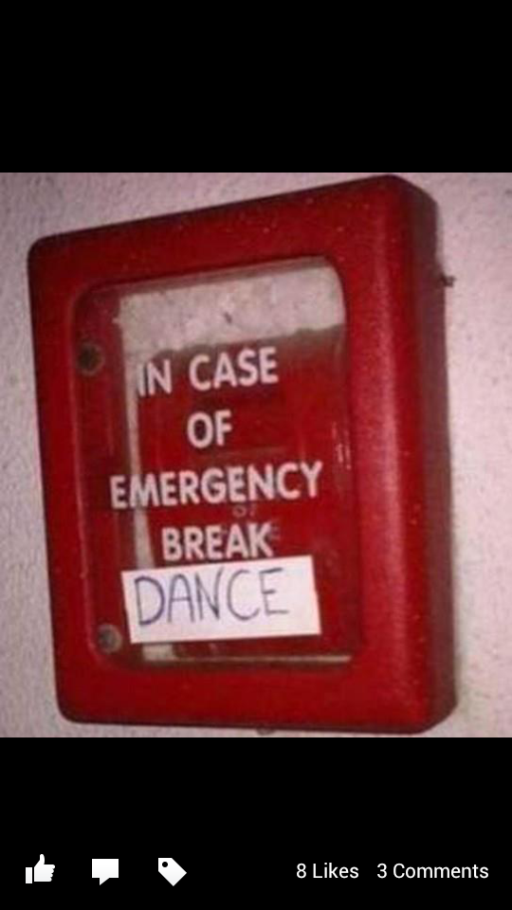
ENTRY # 8

Slide 16
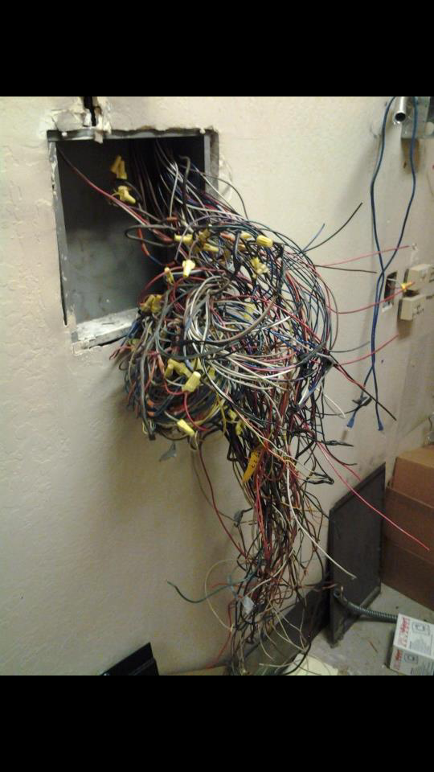
ENTRY # 9

Slide 17
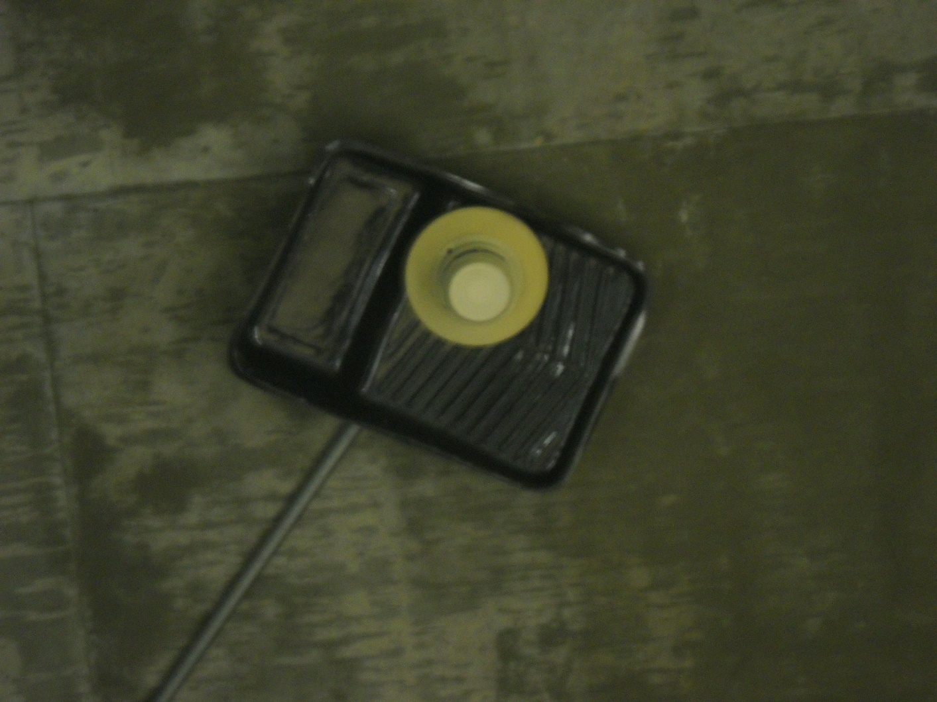
ENTRY # 10

Slide 18
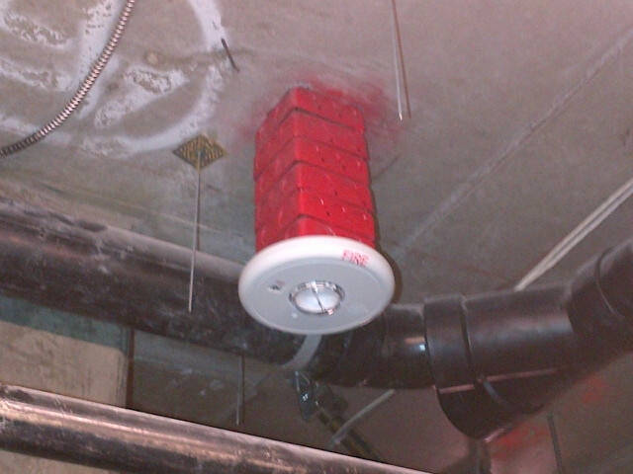
ENTRY # 11

Slide 19
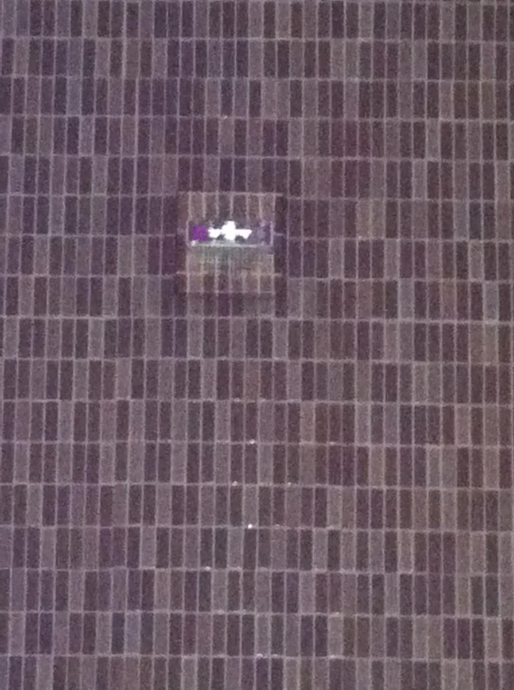
ENTRY # 12

Slide 20
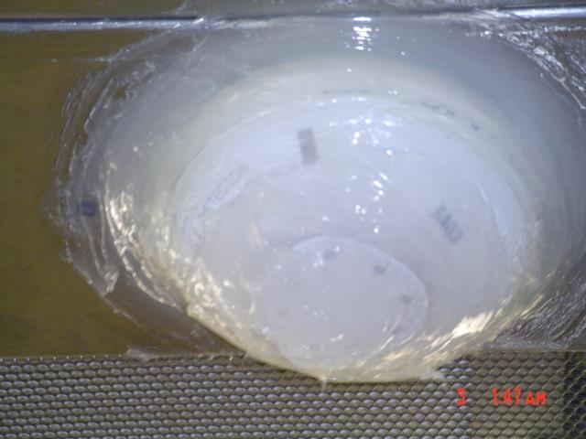
ENTRY # 13

Slide 21
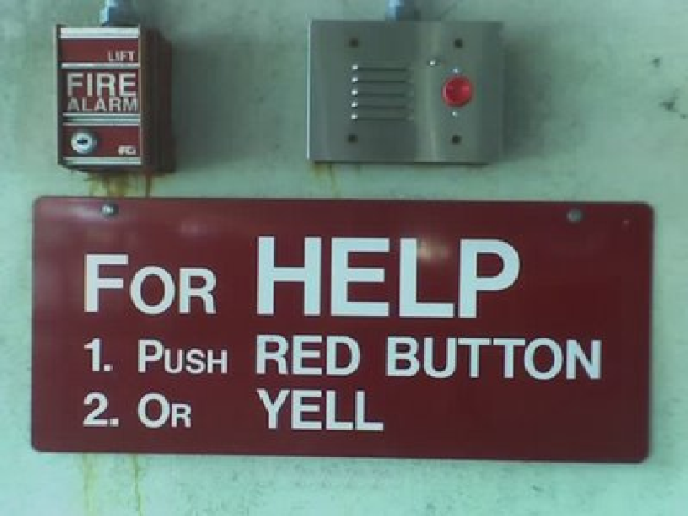
ENTRY # 14

Slide 22
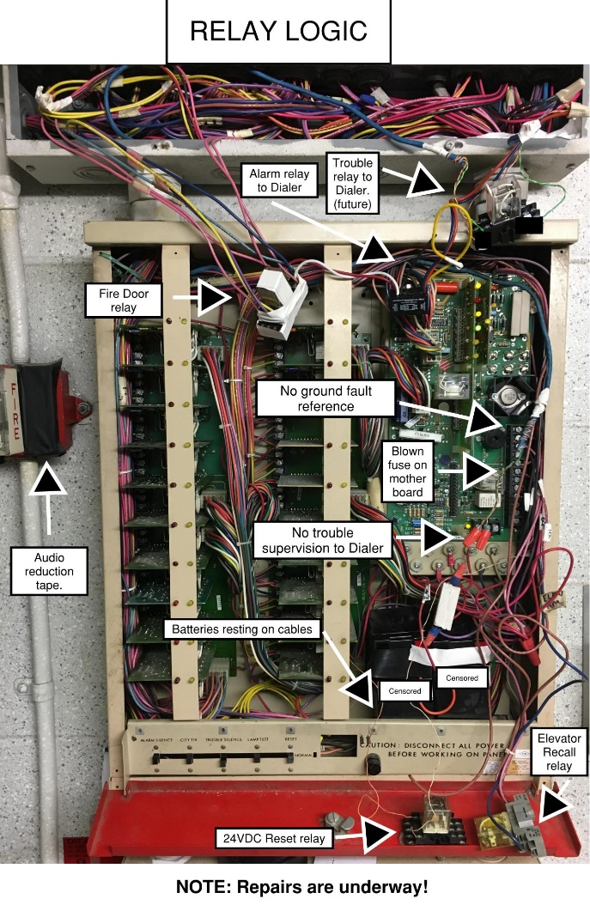
ENTRY # 15

Slide 23
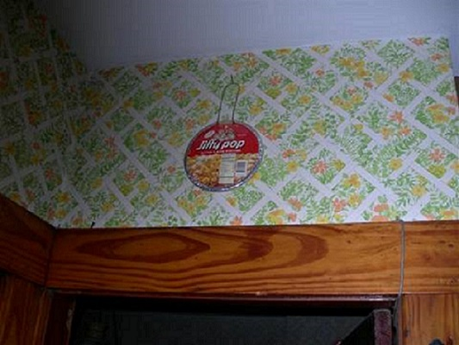
ENTRY # 16

Slide 24
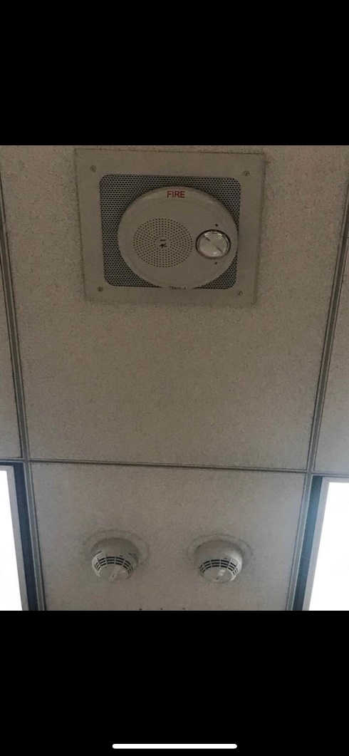
ENTRY # 17

Slide 25
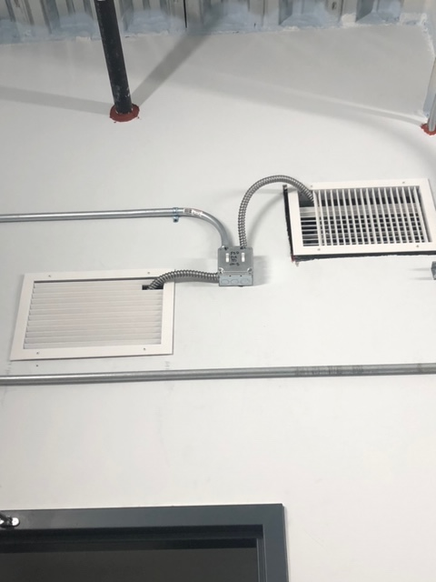
ENTRY # 18

Slide 26
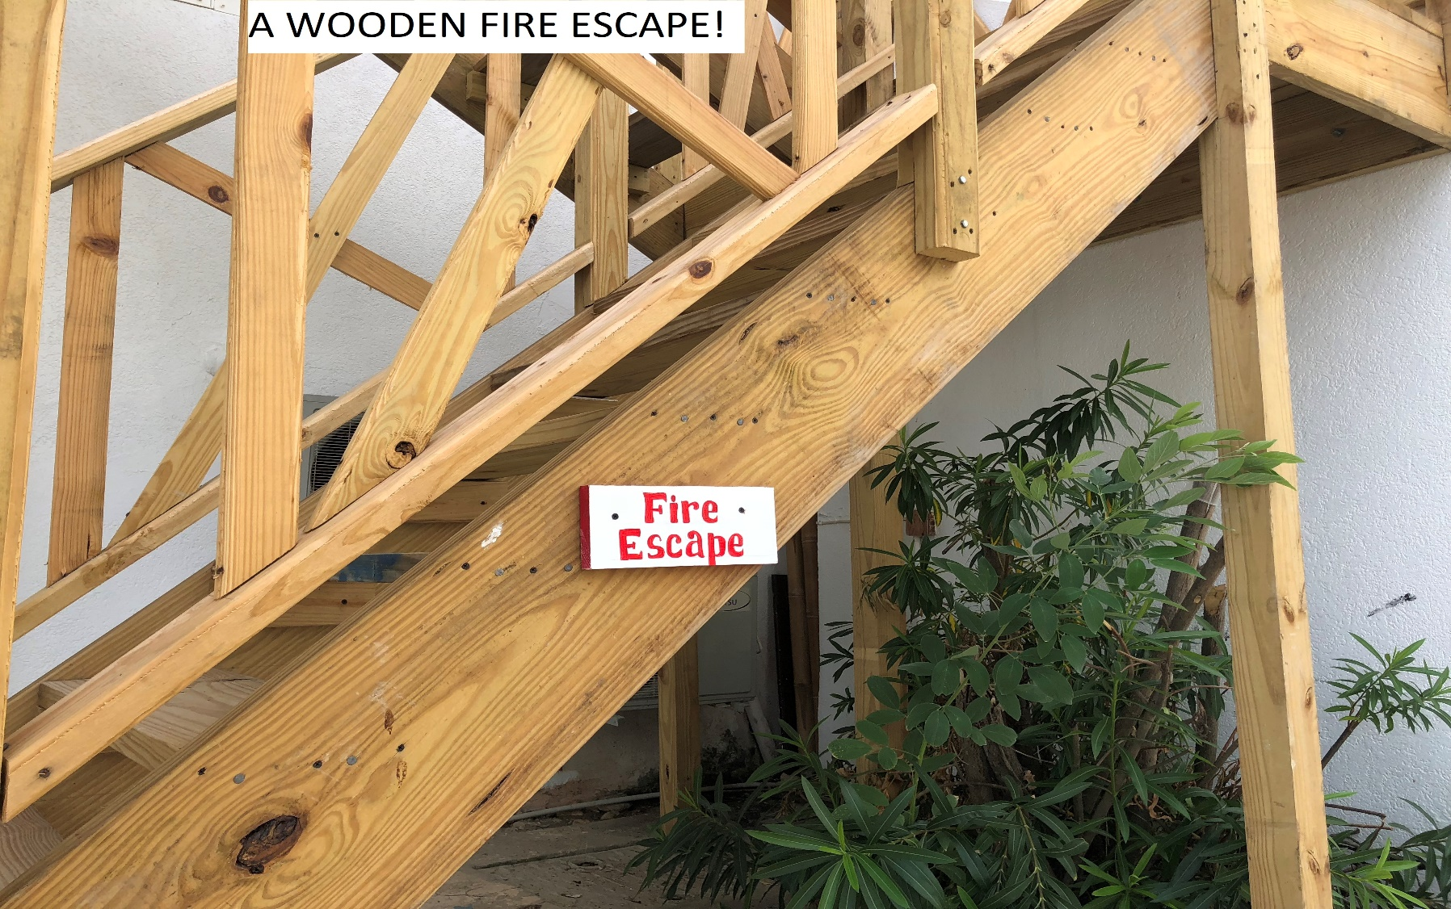
ENTRY #19

Slide 27
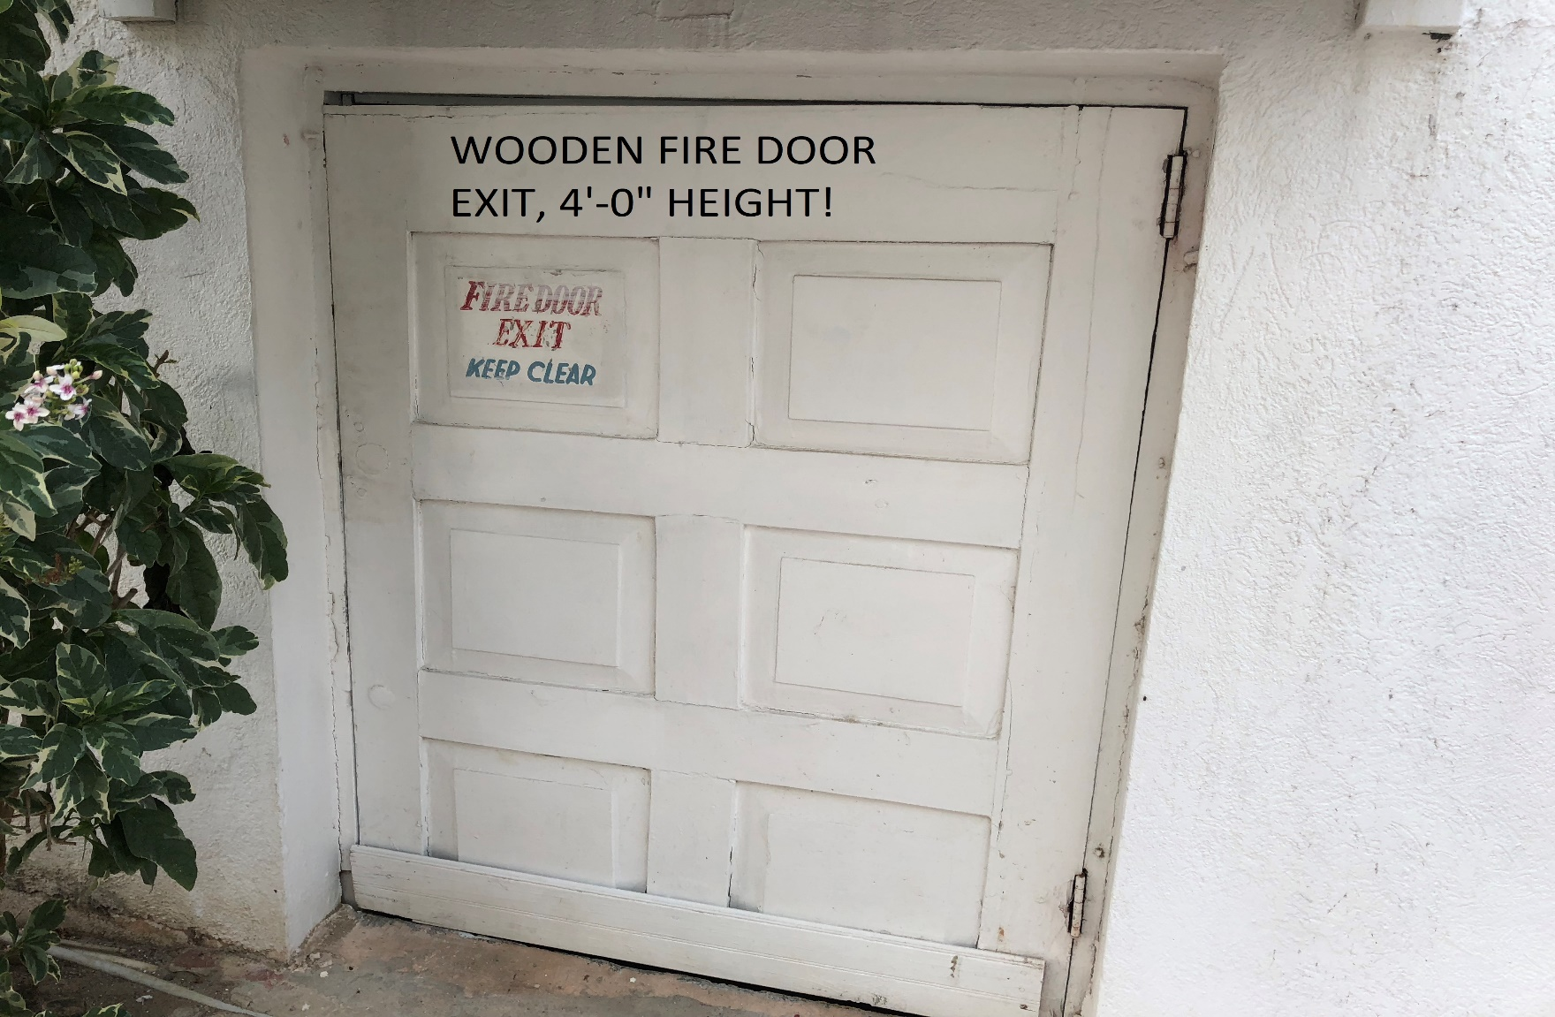
ENTRY # 20

Slide 28
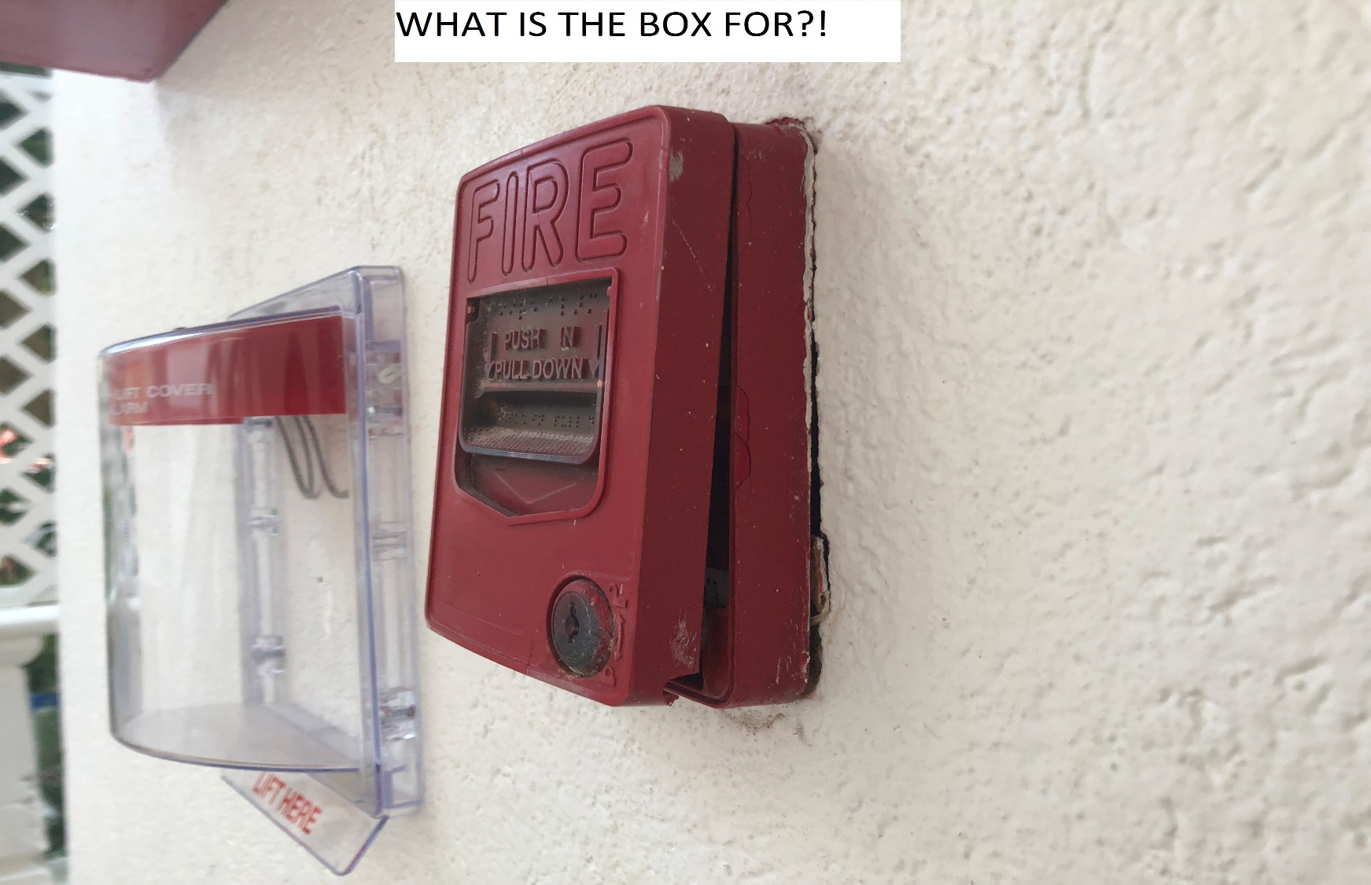
ENTRY # 21

Slide 29
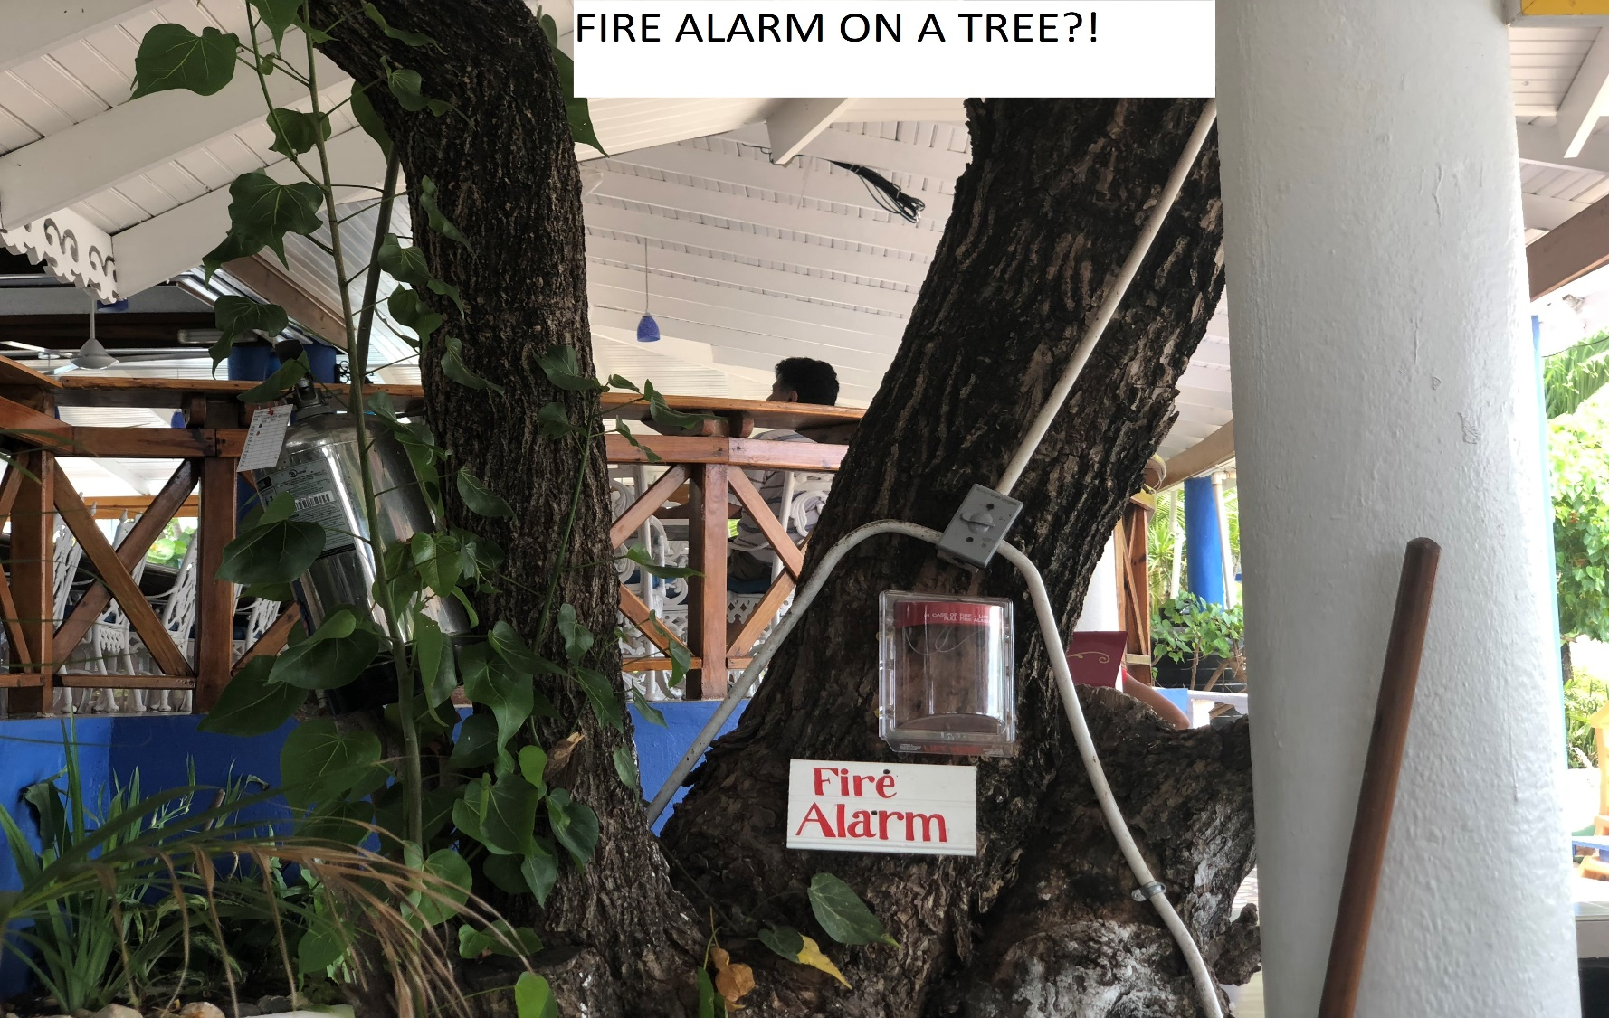
ENTRY # 22

Slide 30
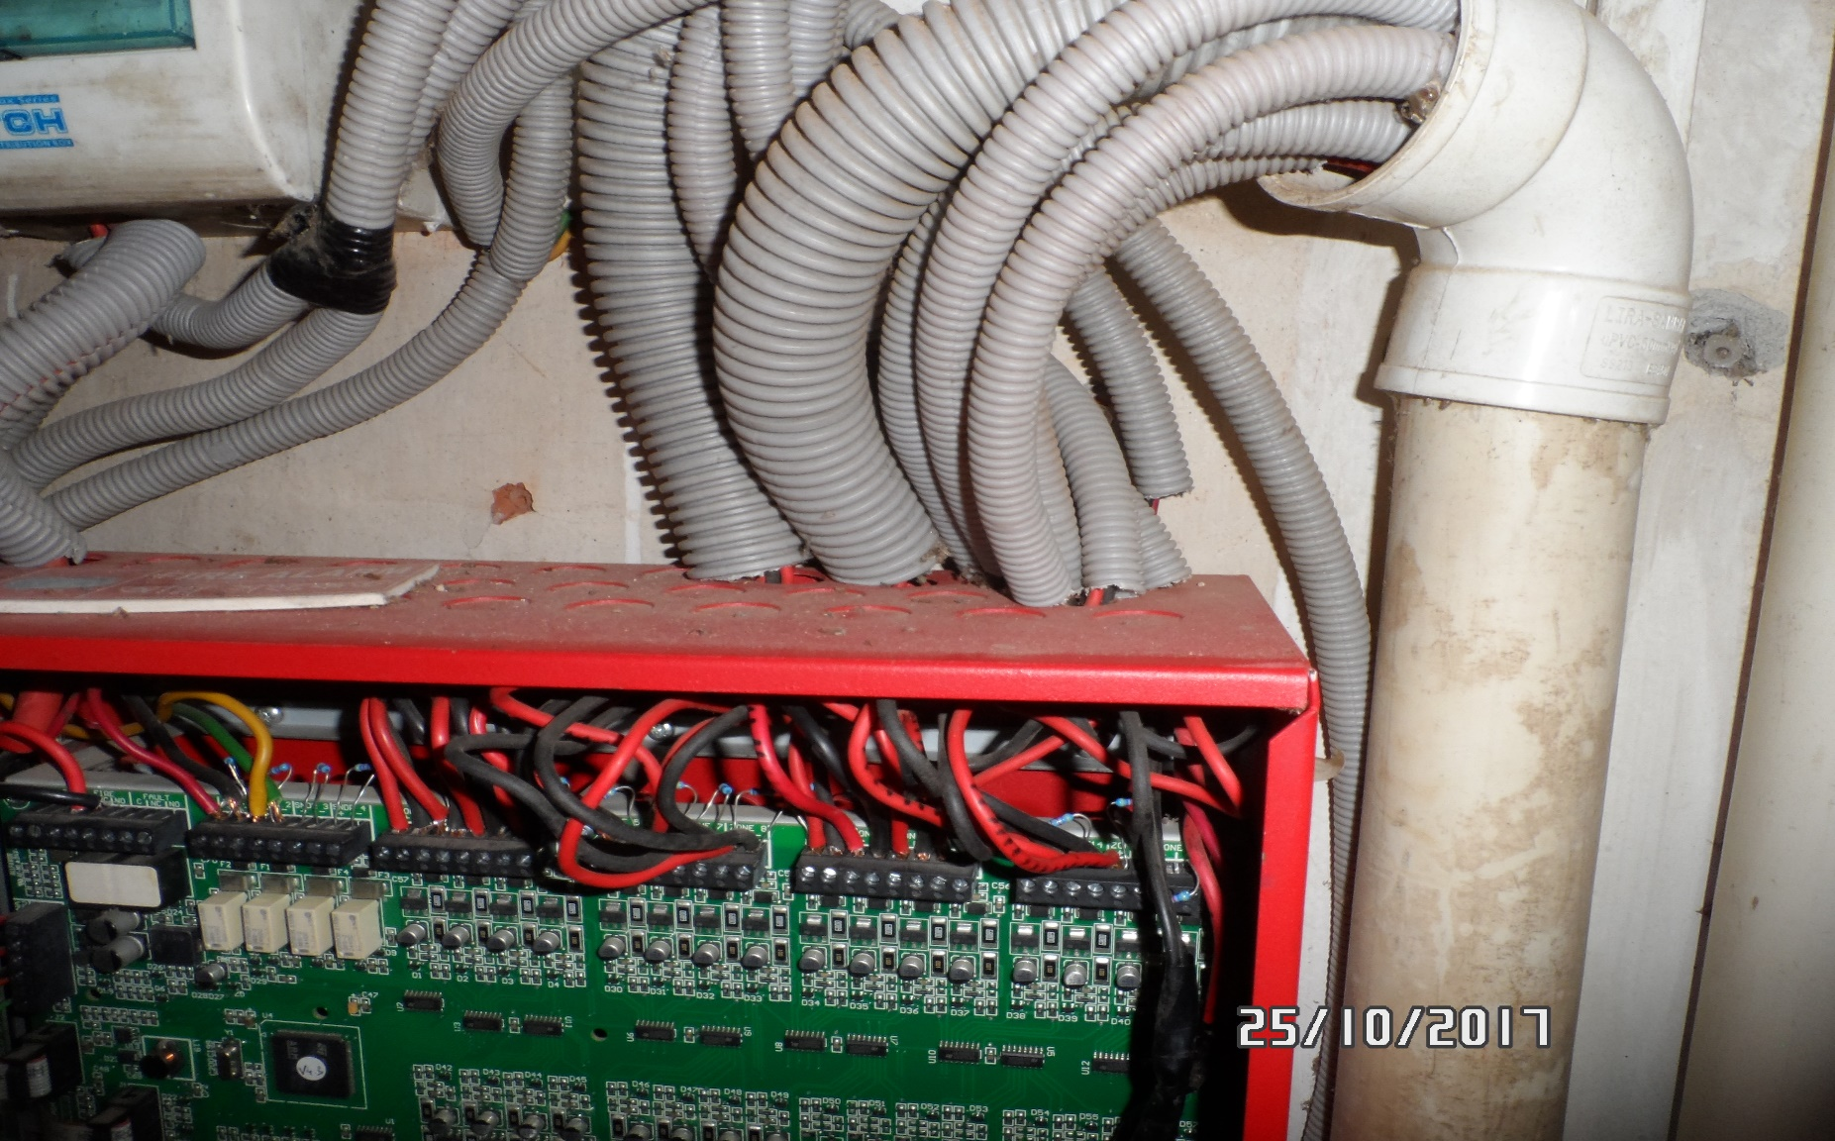
ENTRY # 23

Slide 31
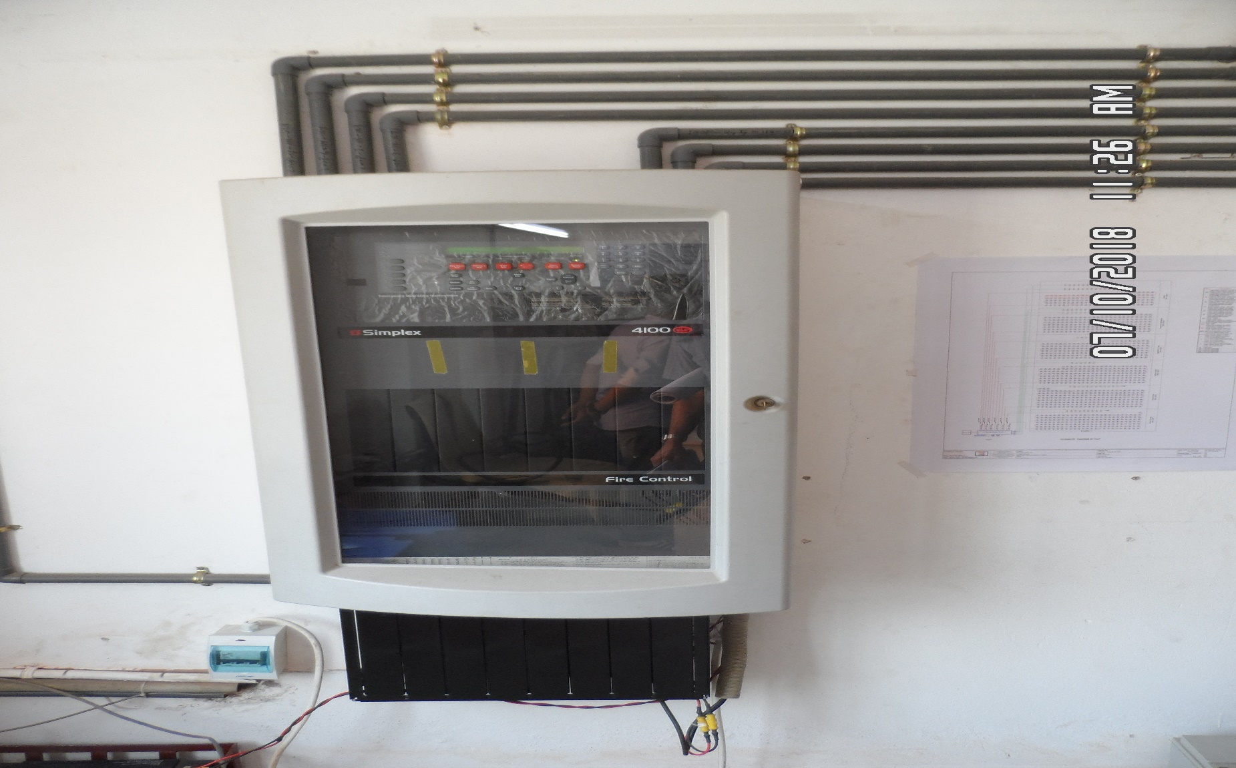
ENTRY # 24-1

Slide 32
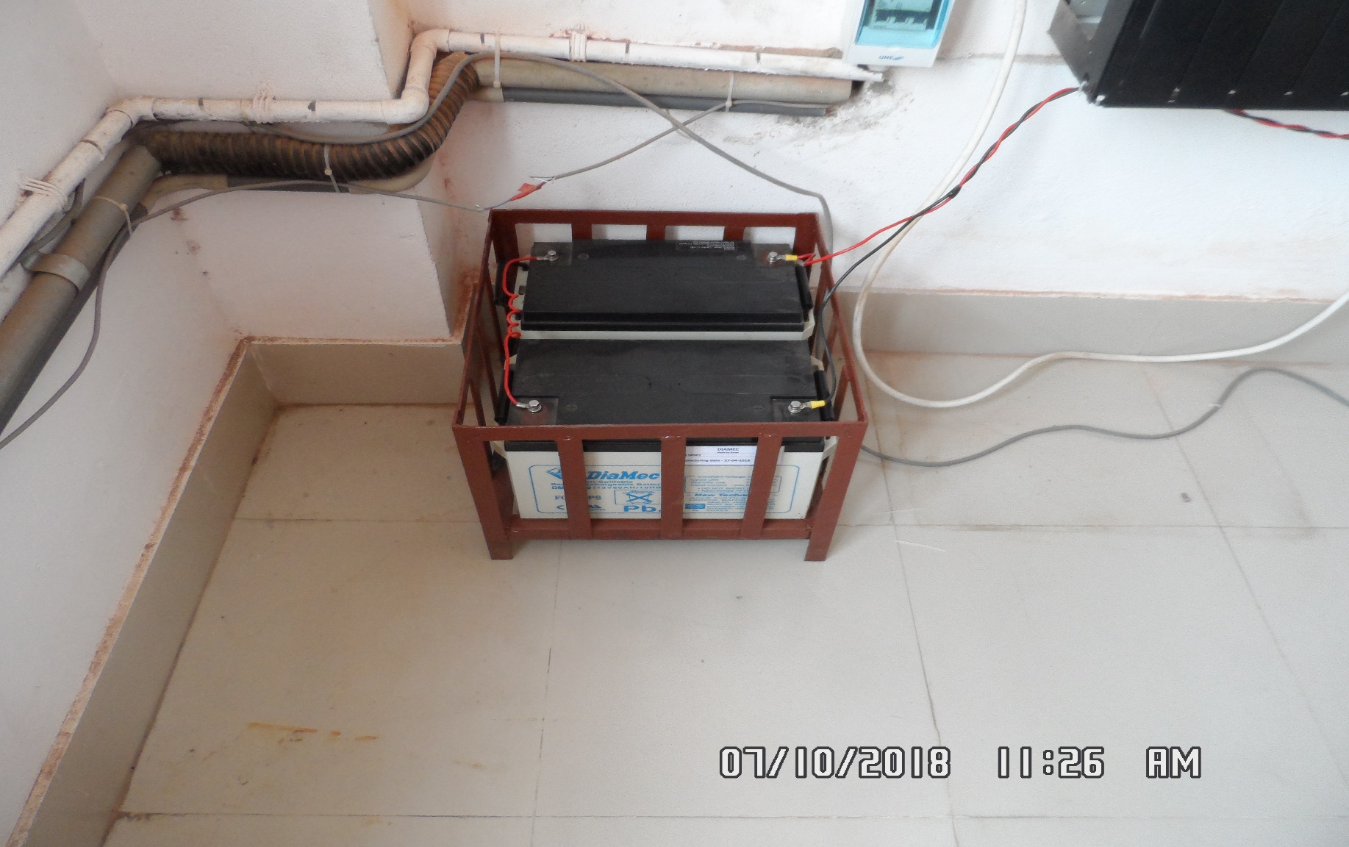
ENTRY # 24-2

Slide 33
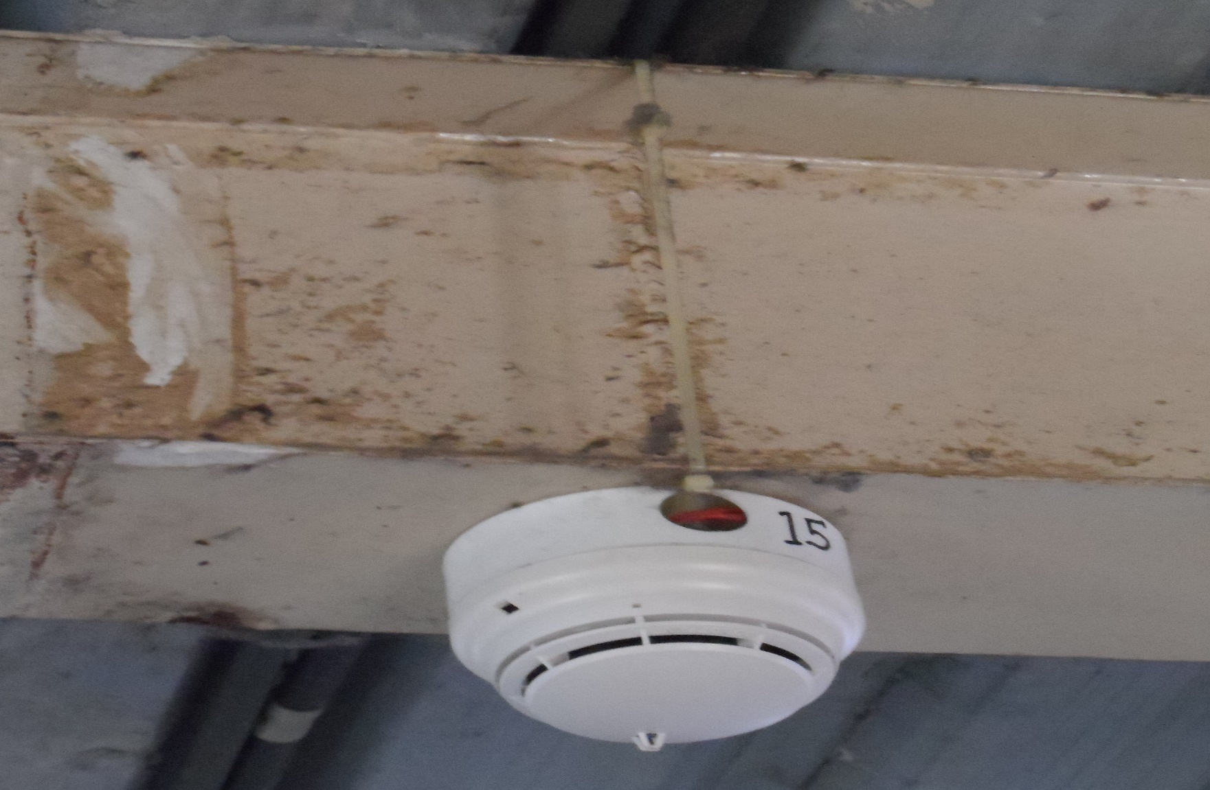
ENTRY # 25

Slide 34
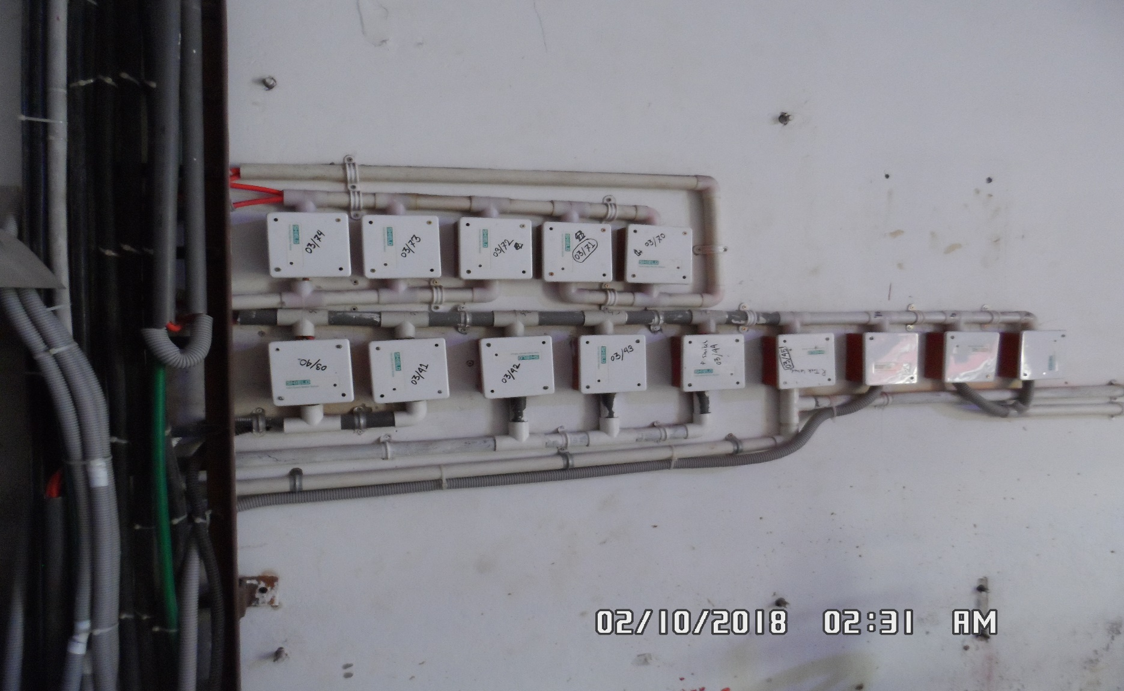
ENTRY # 26

Slide 35
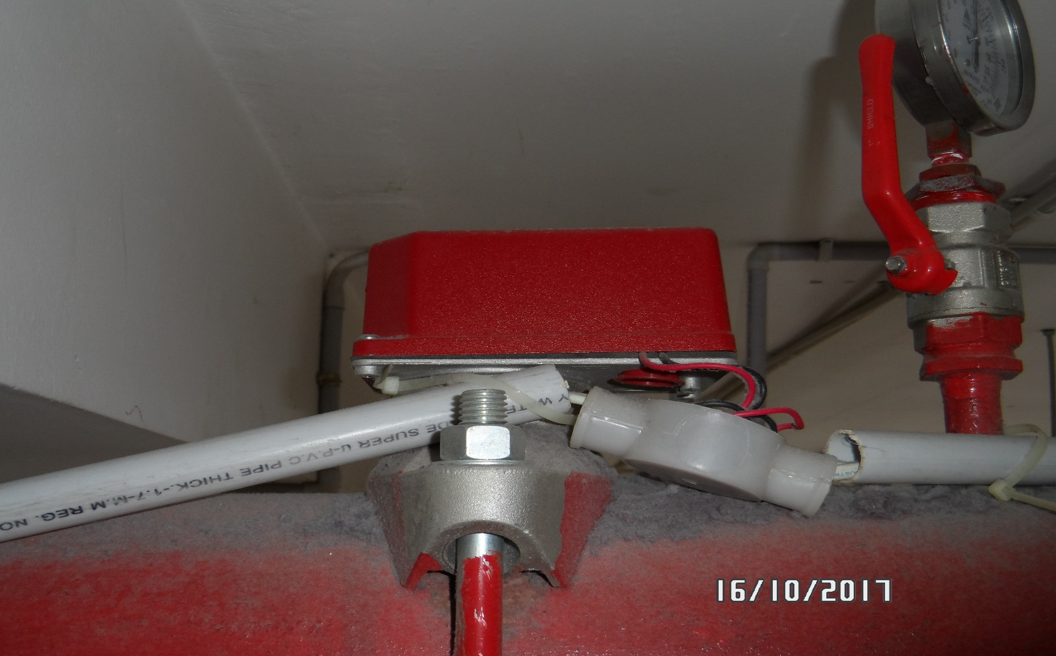
ENTRY # 27

Slide 36
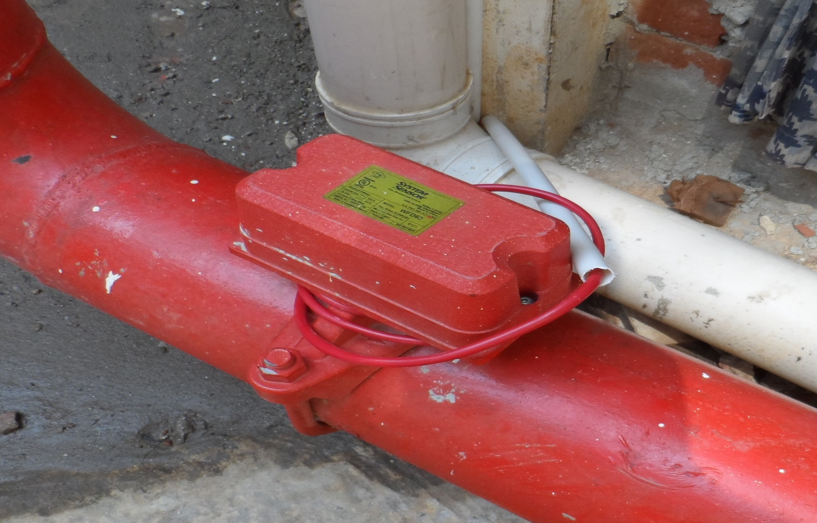
ENTRY # 28

Slide 37
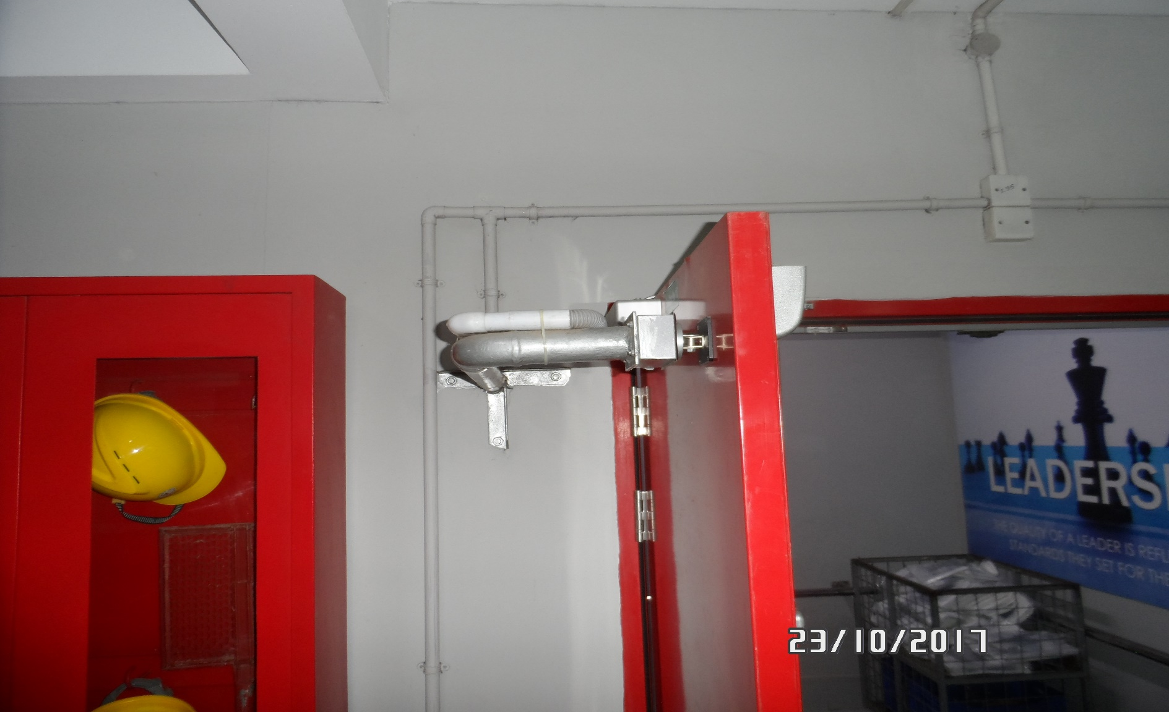
ENTRY # 29

Slide 38
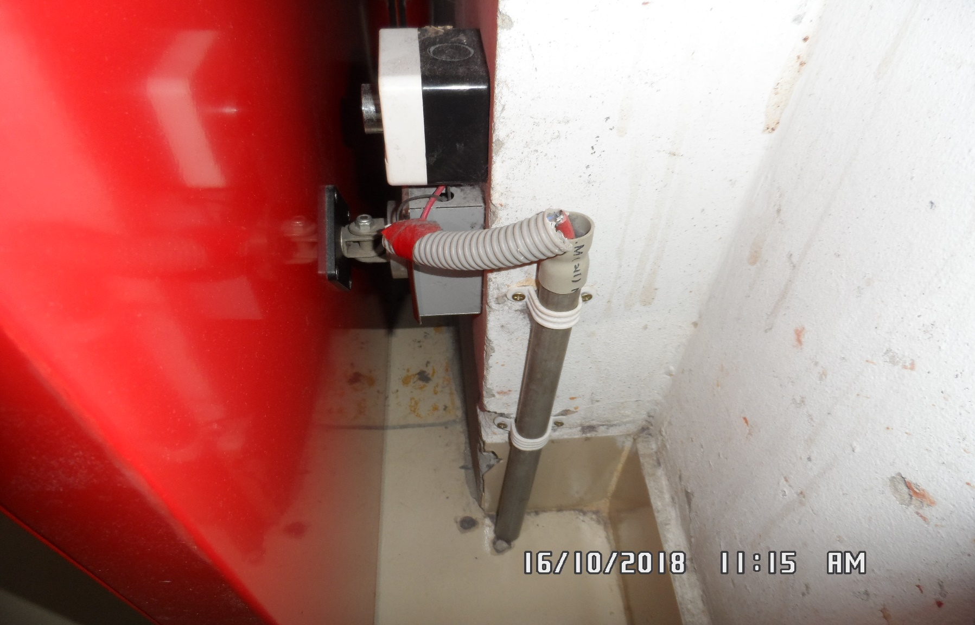
ENTRY # 30

Slide 39
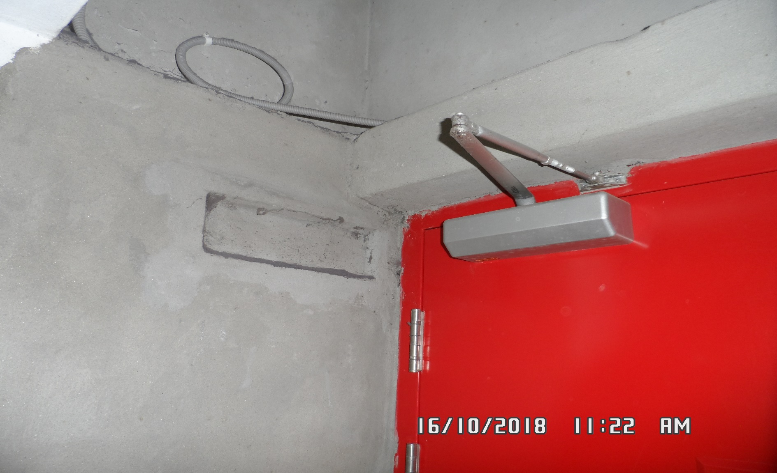
ENTRY # 31

Slide 40
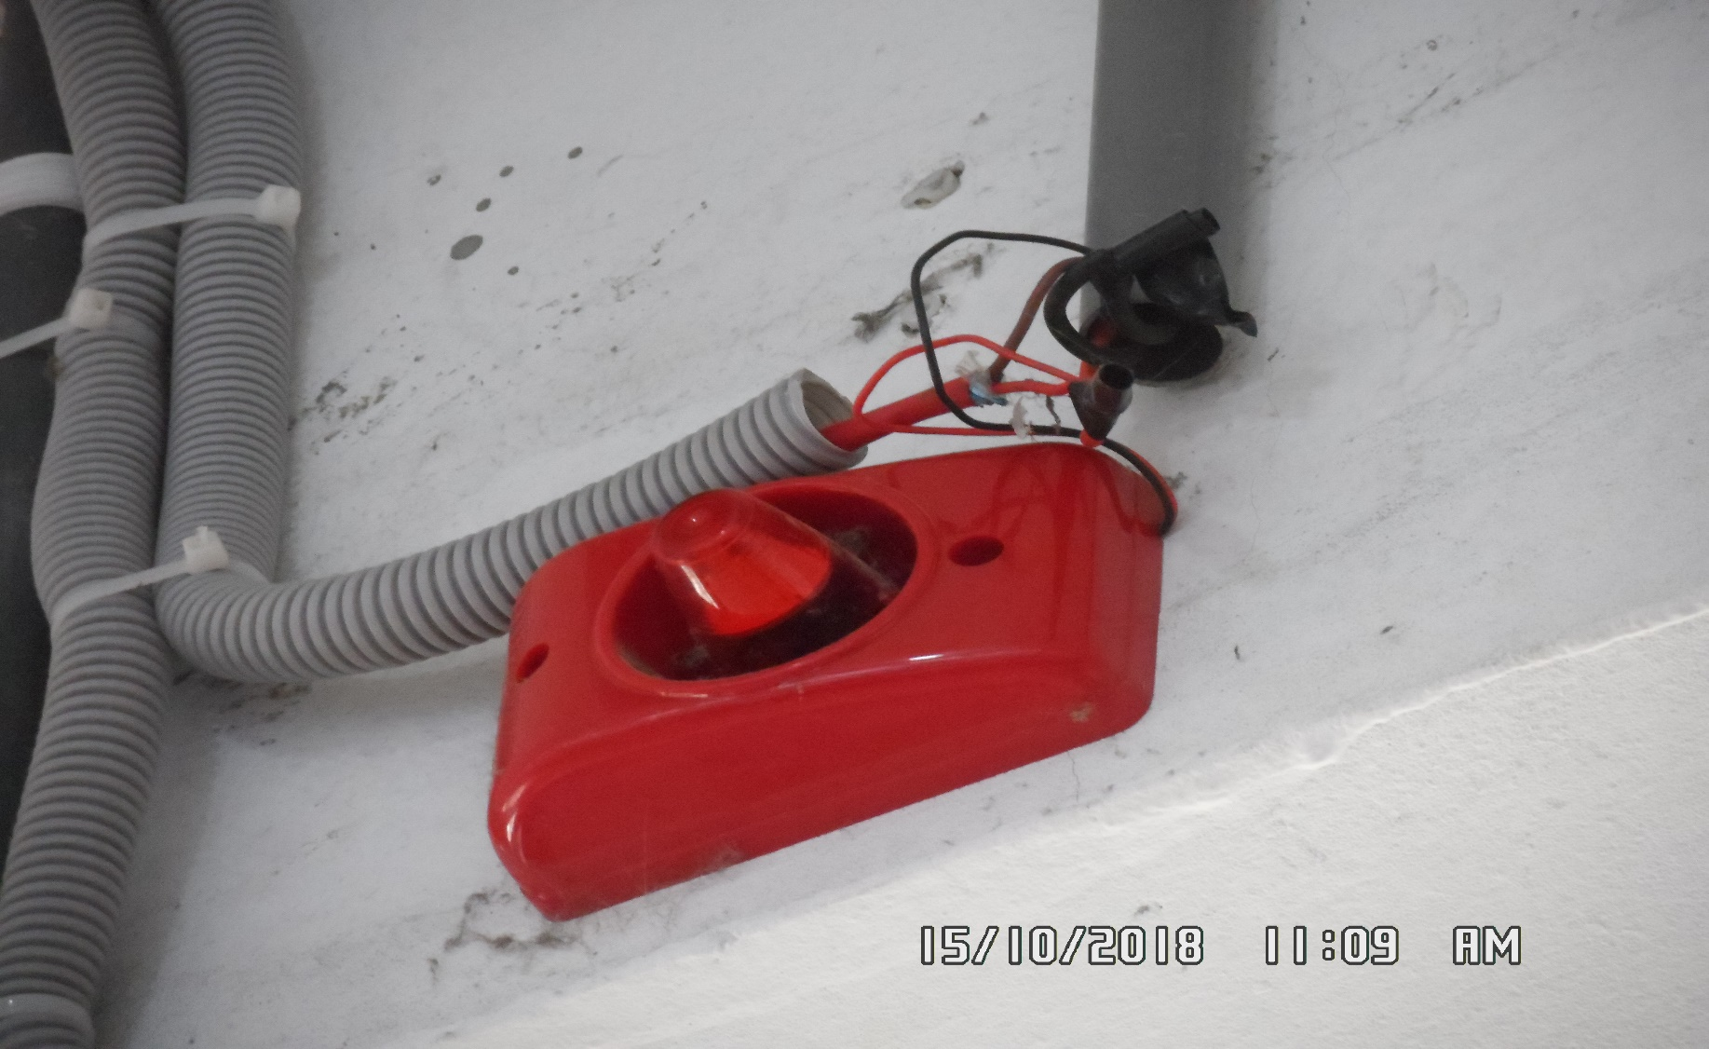
ENTRY # 32

Slide 41
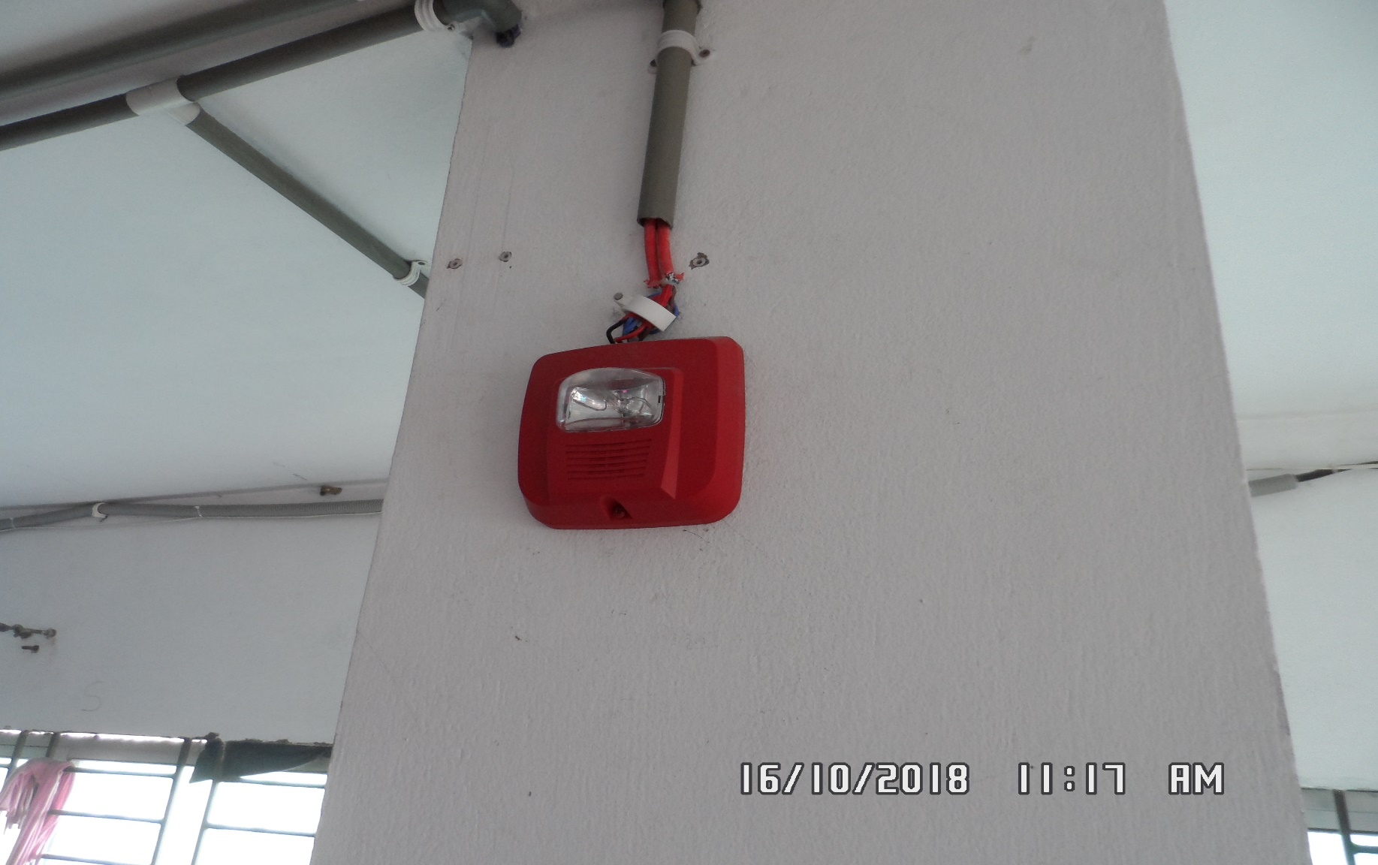
ENTRY # 33

Slide 42
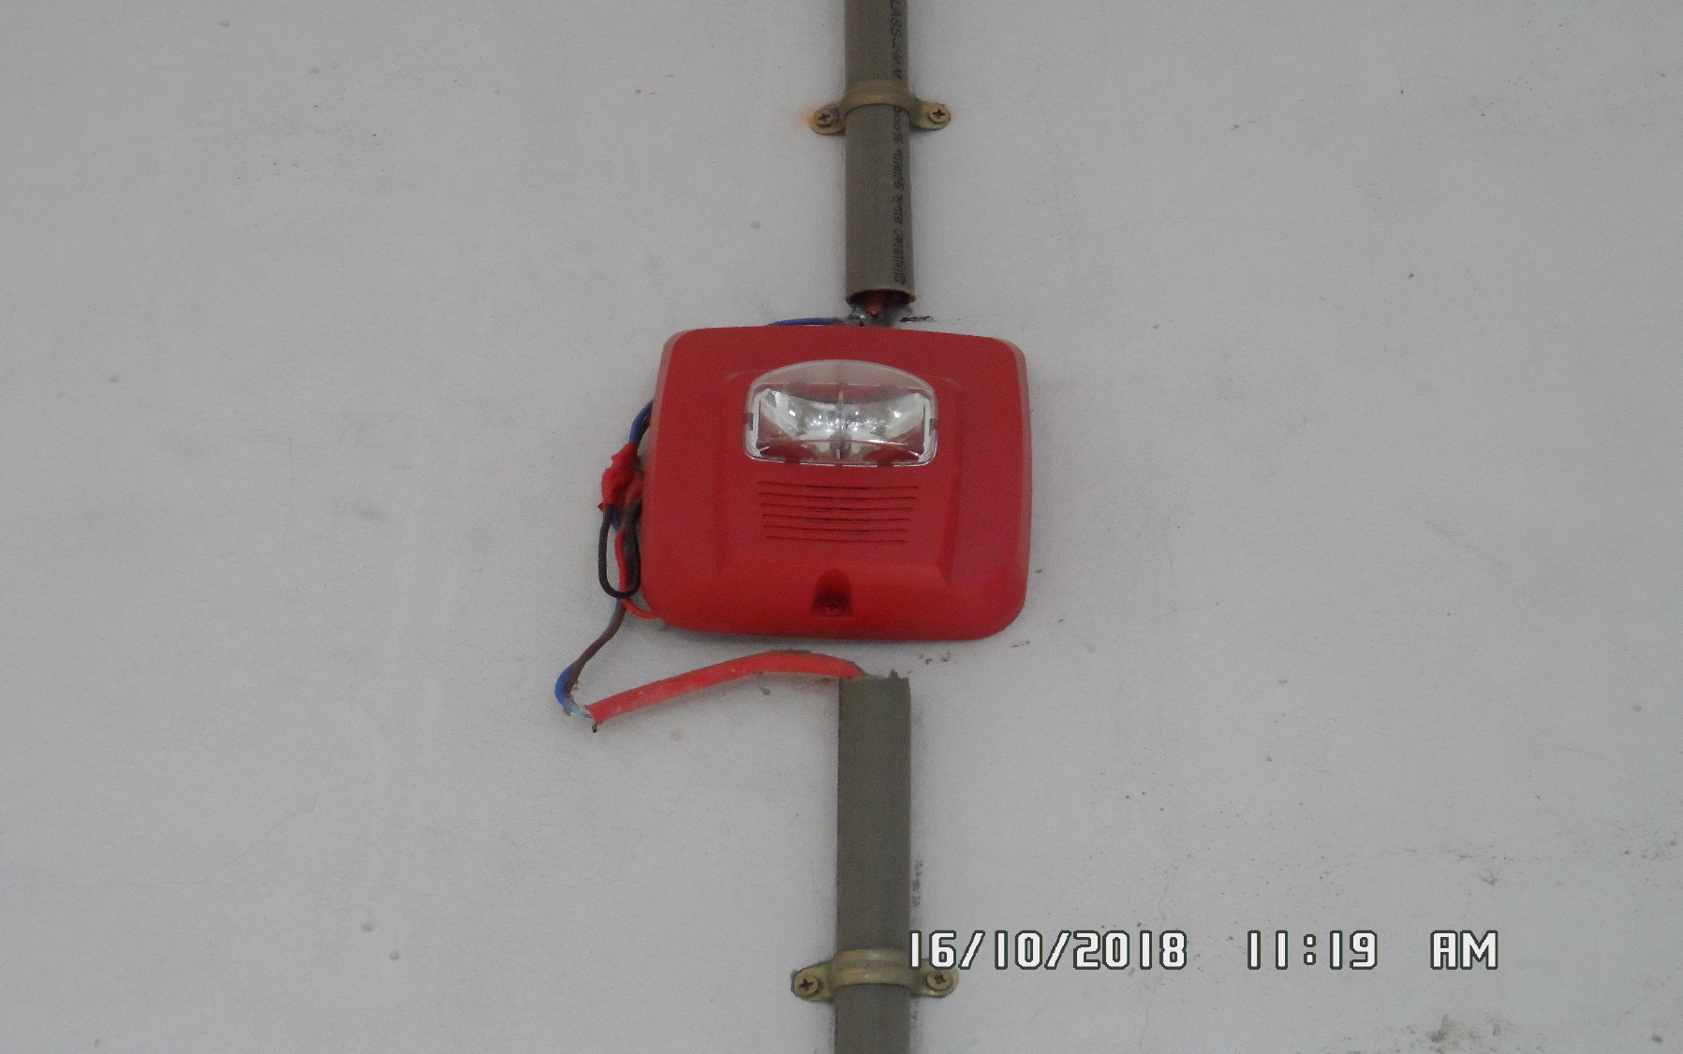
ENTRY # 34

Slide 43
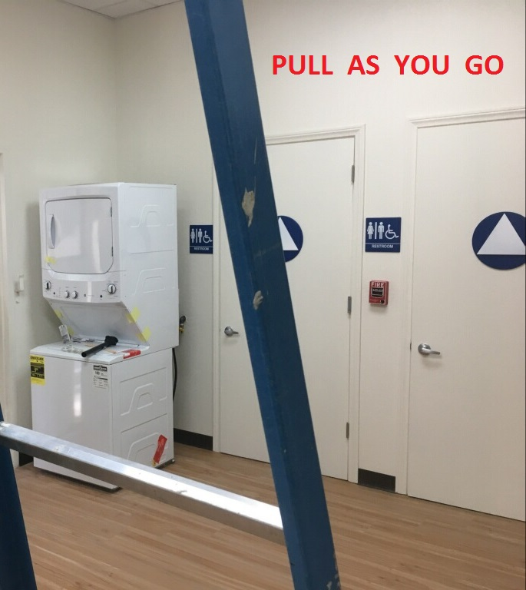
ENTRY # 35

Slide 44
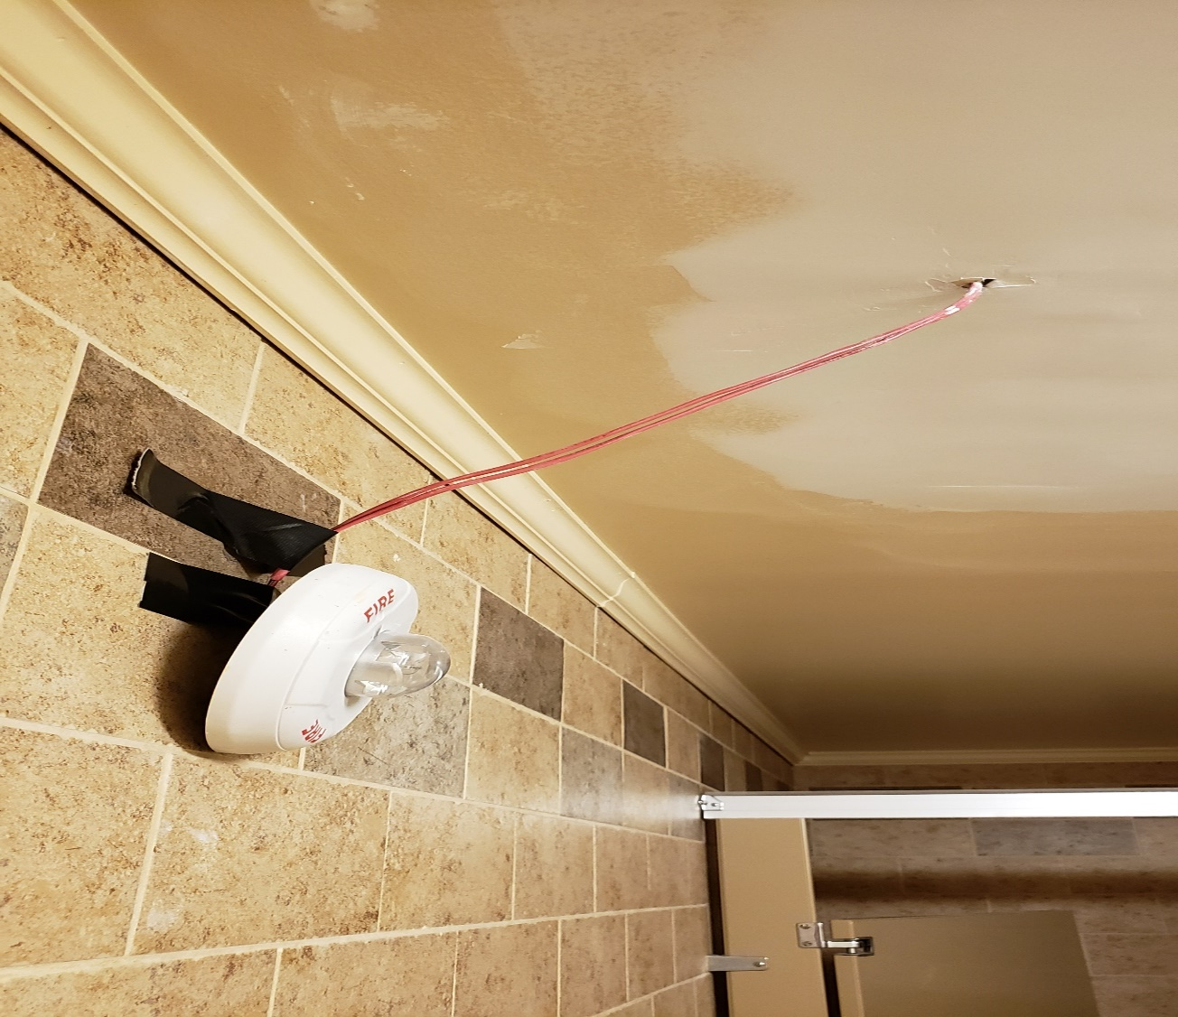
ENTRY # 36

Slide 45
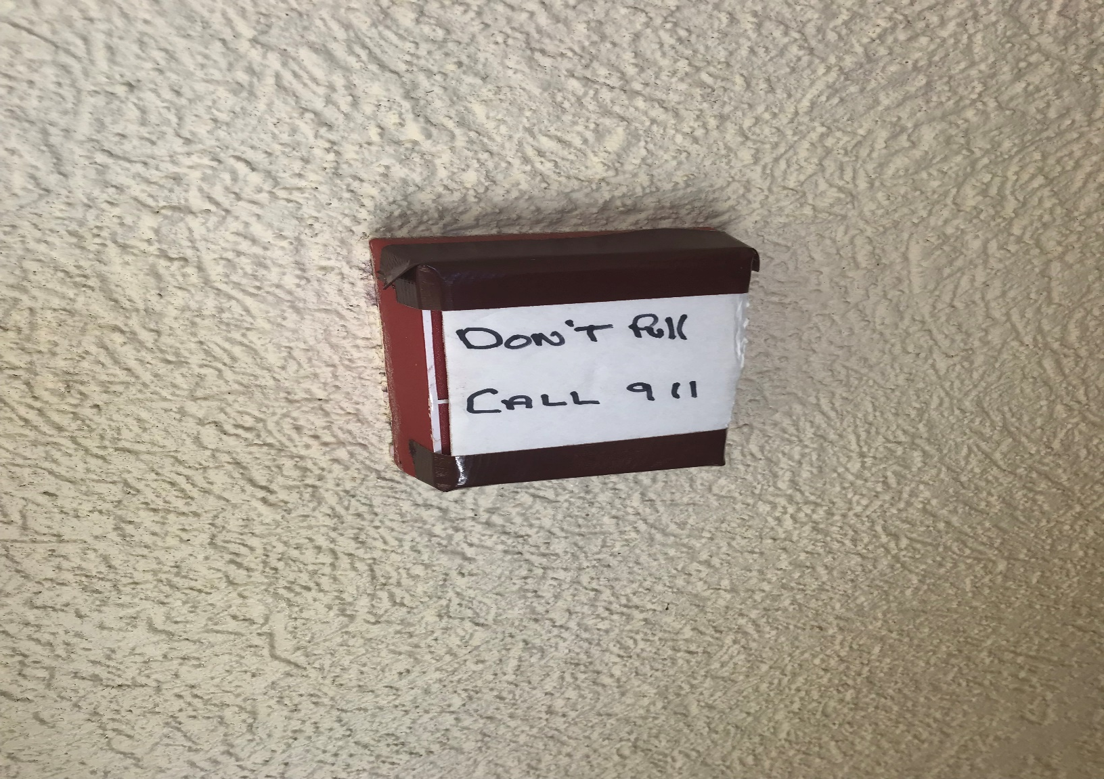
ENTRY # 37

Slide 46
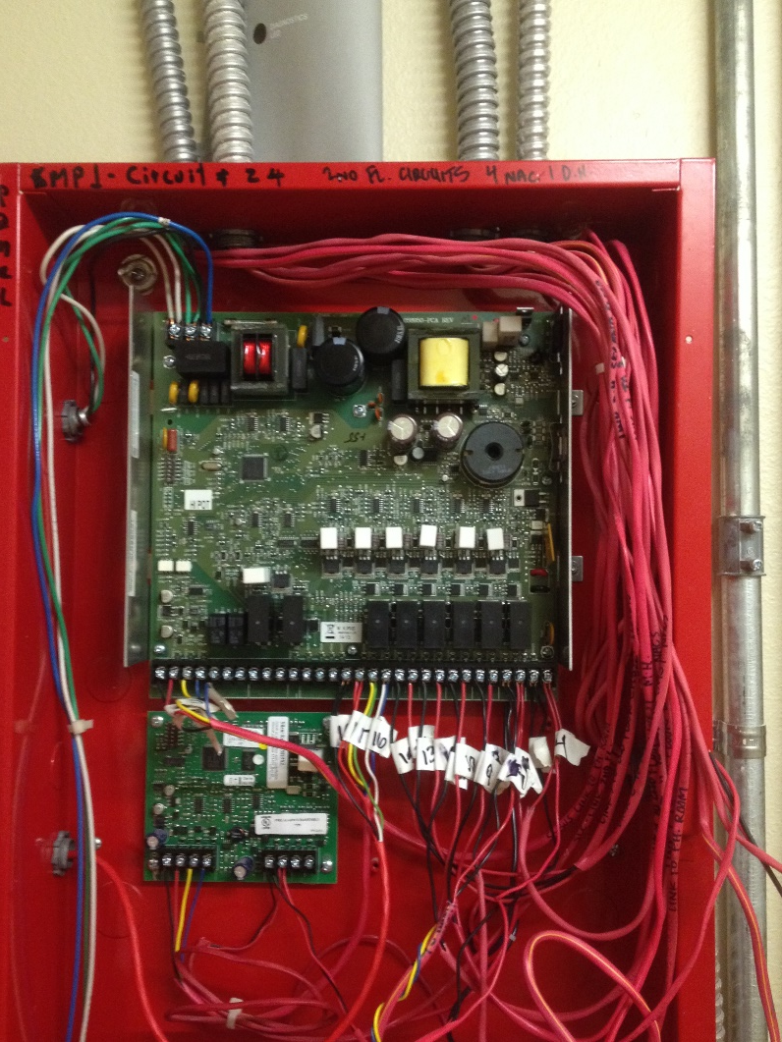
ENTRY # 38

Slide 47
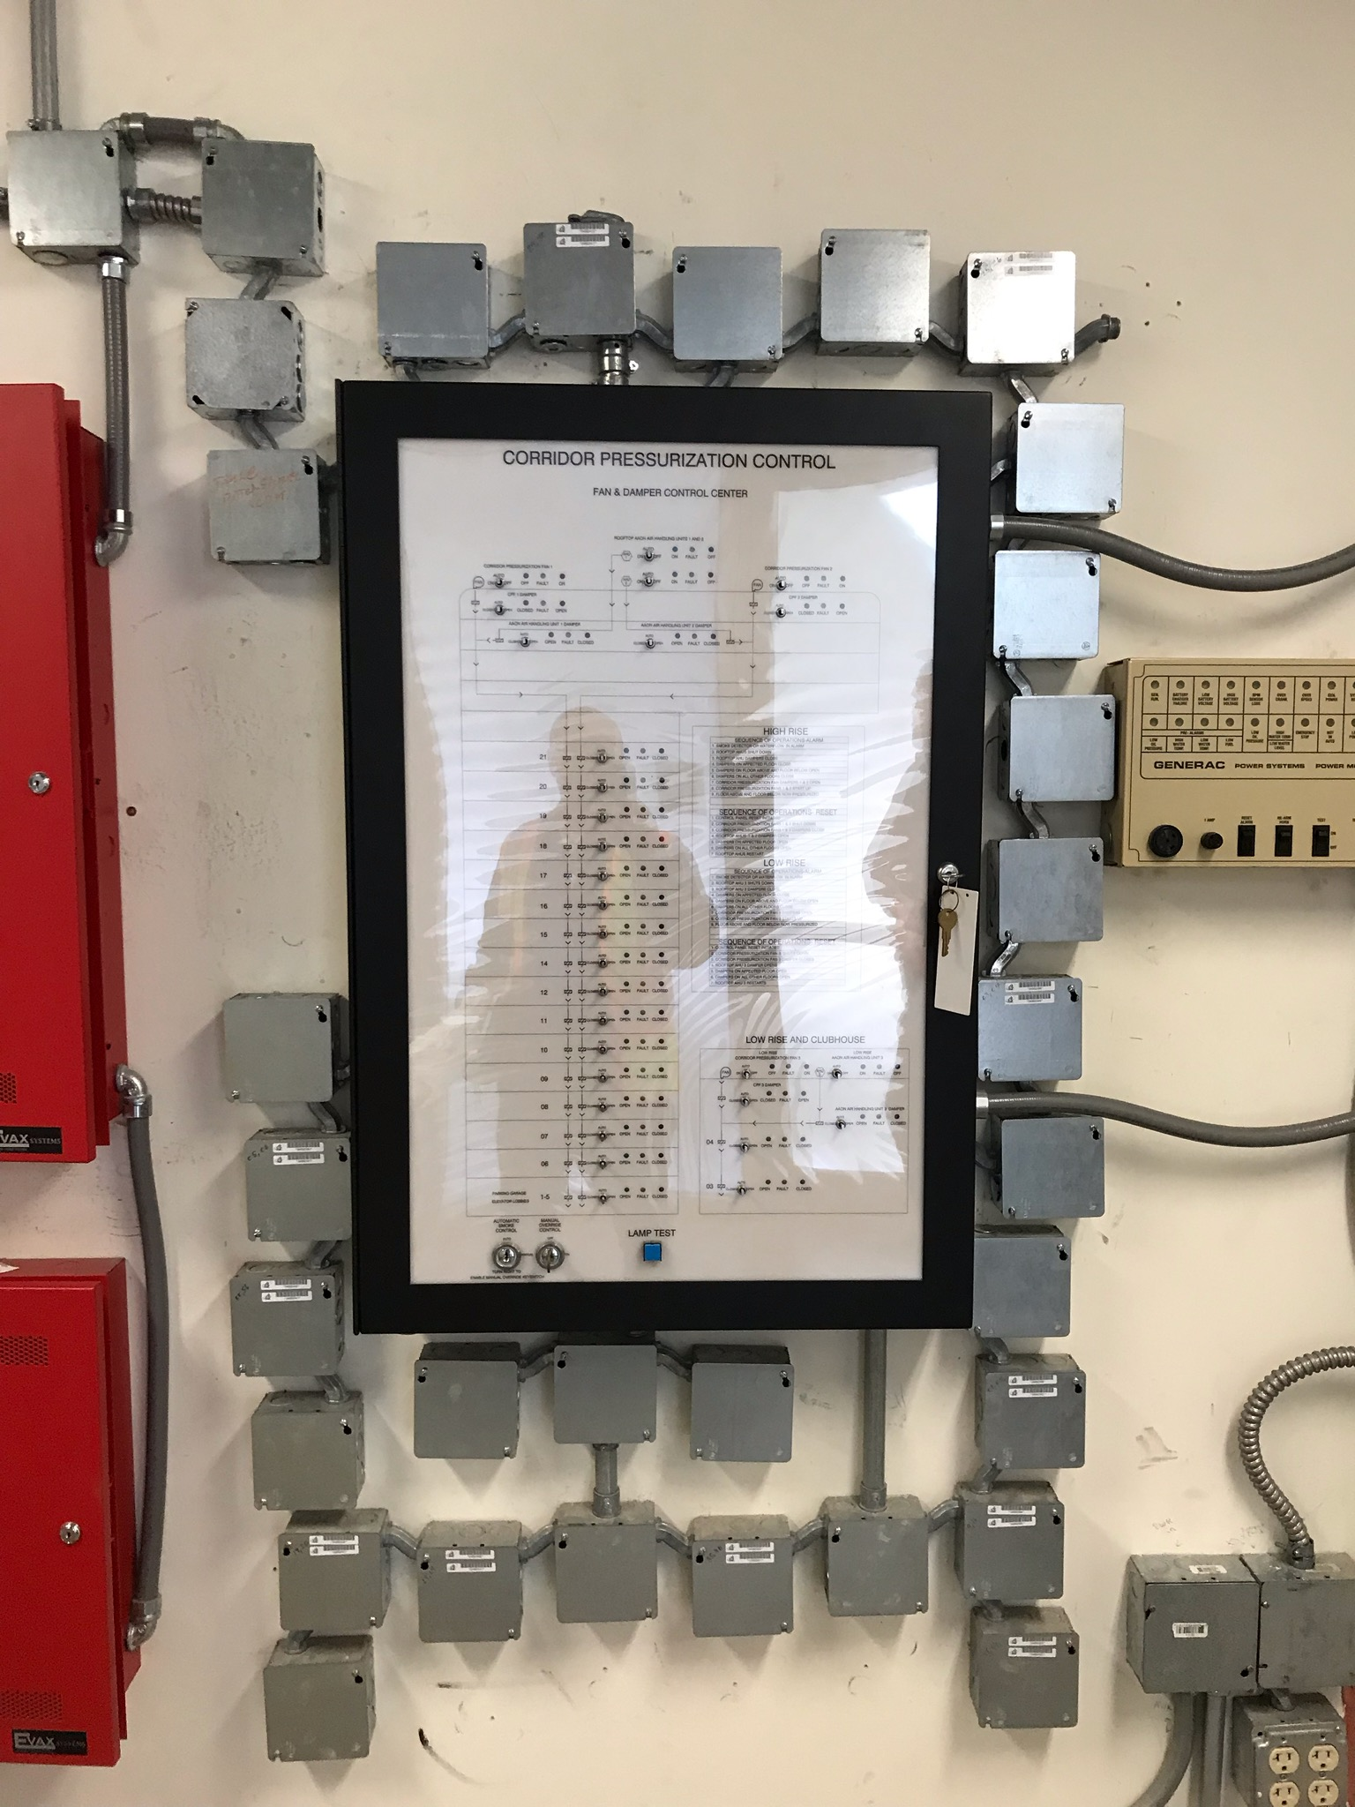
ENTRY # 39

Slide 48
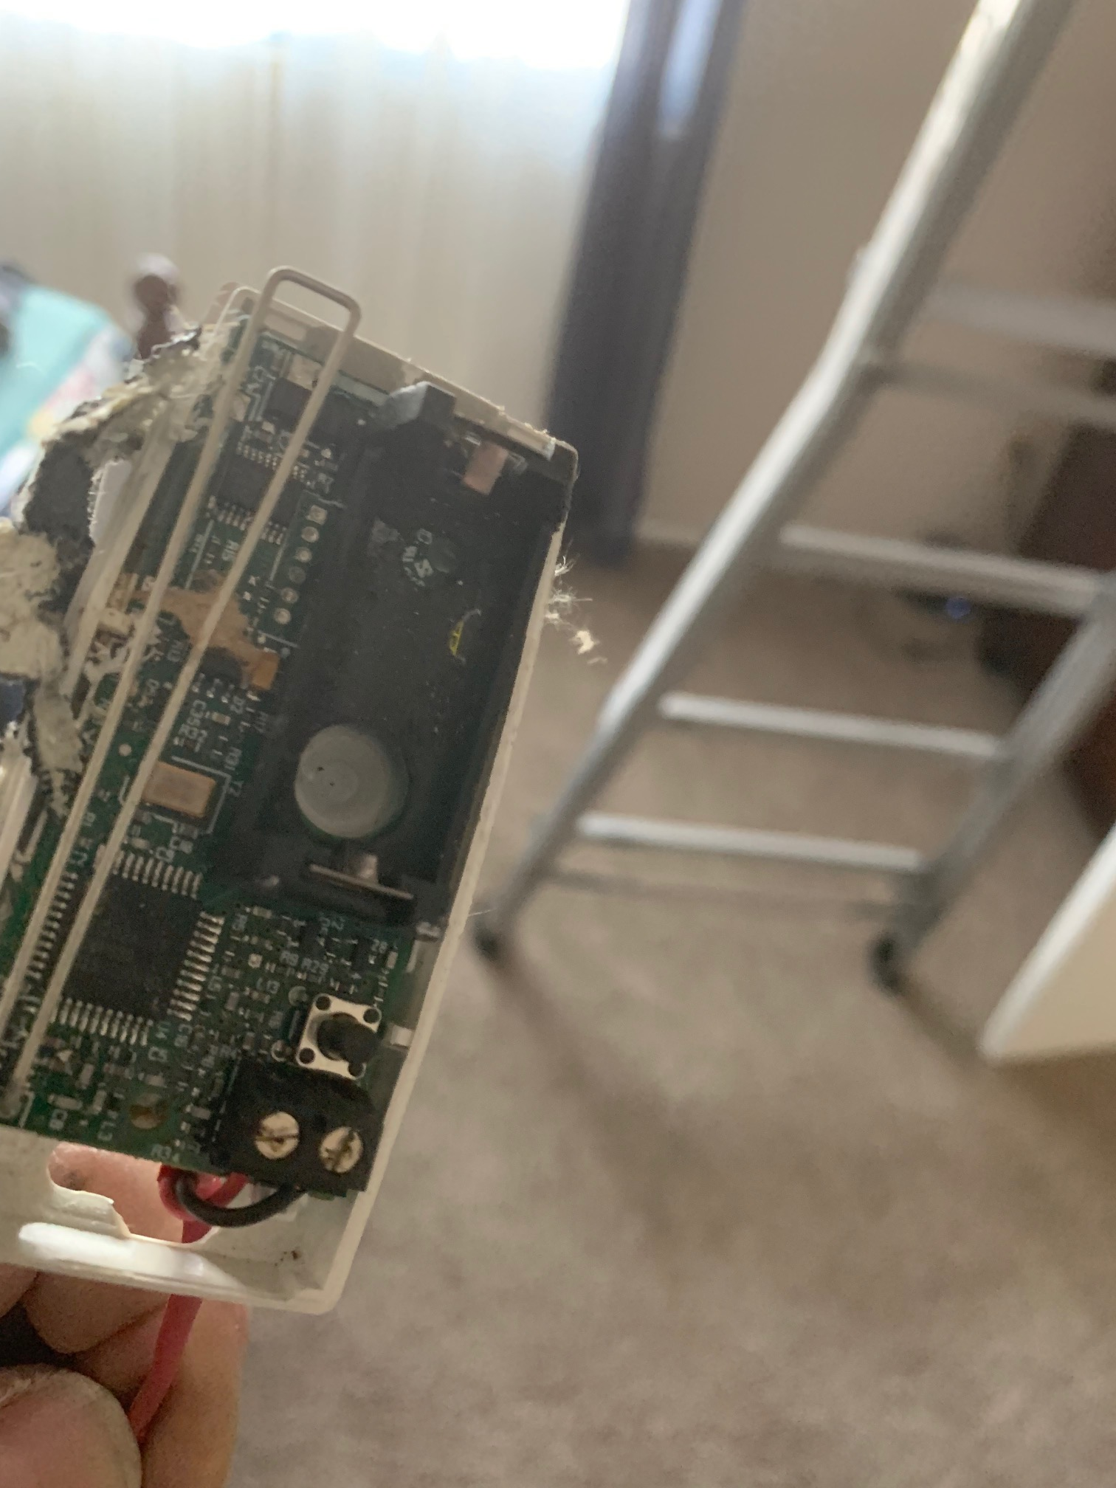
ENTRY # 40-1

Slide 49
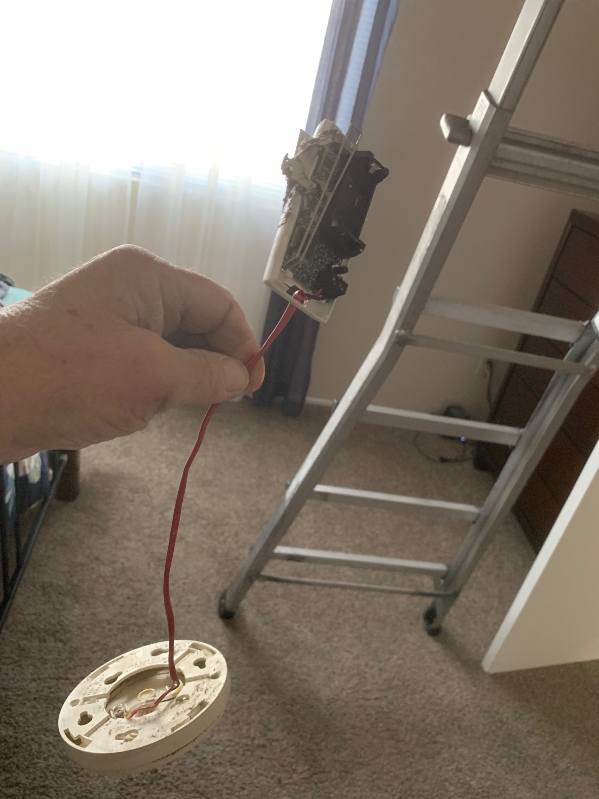
ENTRY # 40-2

Slide 50

ENTRY # 40-3

Slide 51

ENTRY # 40-4

Slide 52

NON-COMPETING ENTRY #1

Slide 53

NON-COMPETING ENTRY #2

Slide 54

NON-COMPETING ENTRY # 3

Slide 55

NON-COMPETING ENTRY # 4

Slide 56

NON-COMPETING ENTRY # 5

Slide 57

NON-COMPETING ENTRY # 6

Slide 58

NON-COMPETING ENTRY # 7

Slide 59

NON-COMPETING ENTRY # 8

Slide 60

NON-COMPETING PHOTO # 9

Slide 61

NON-COMPETING PHOTO # 10

Slide 62

NON-COMPETING PHOTO # 11

