Slide 1
2018 Annual Conference Spouse Event

Slide 2
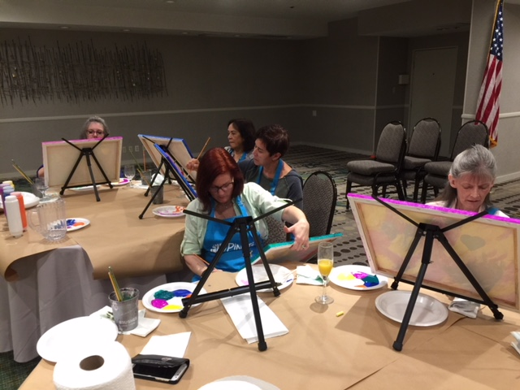

Slide 4
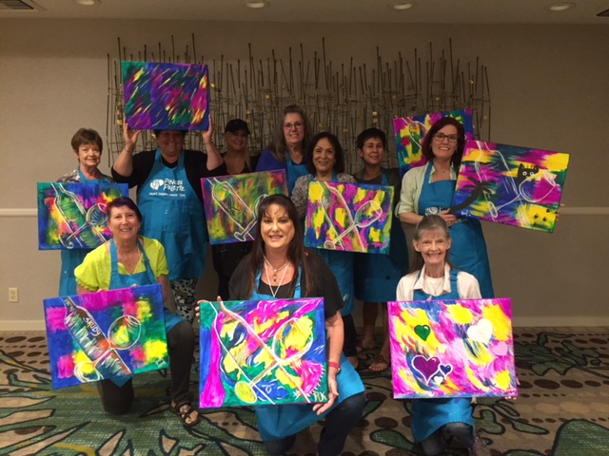

Slide 5
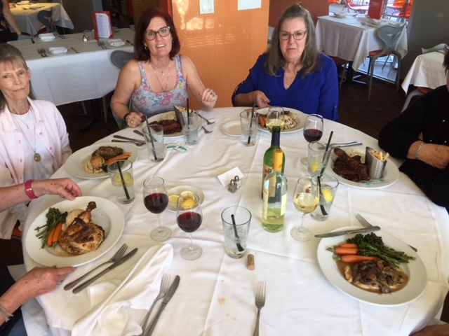

Slide 6
