Slide 1
PHOTOS PROVIDED BY BILL HOPPLE – PAST CAFAA ANNUAL CONFERENCES

Slide 2
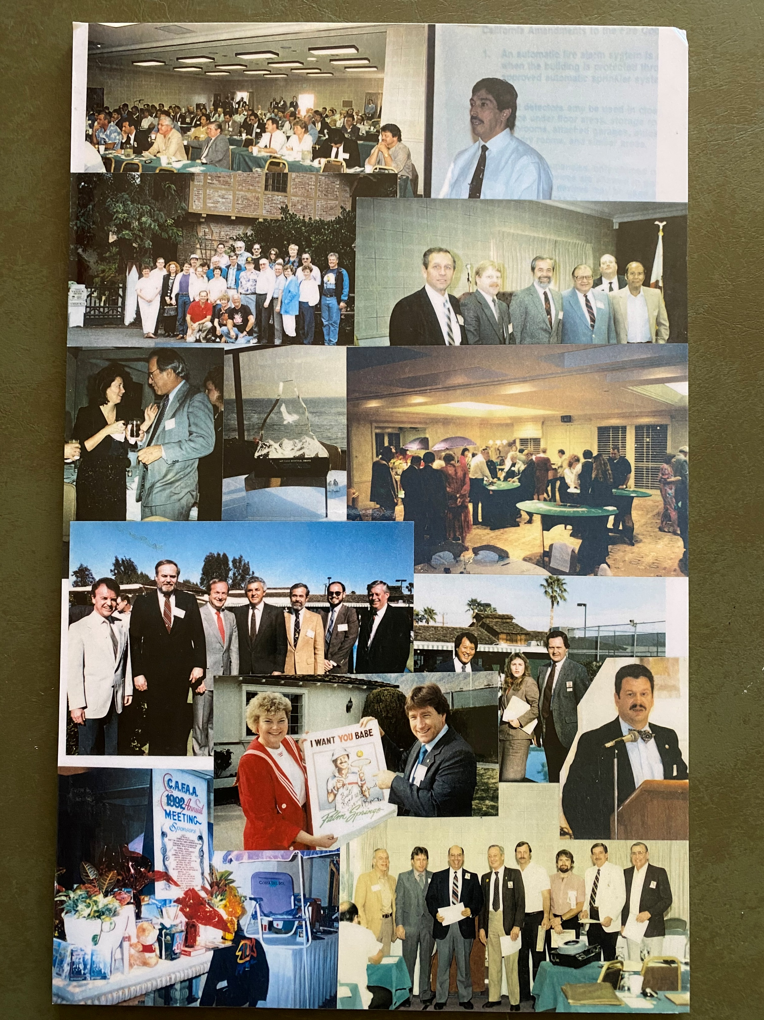

Slide 3
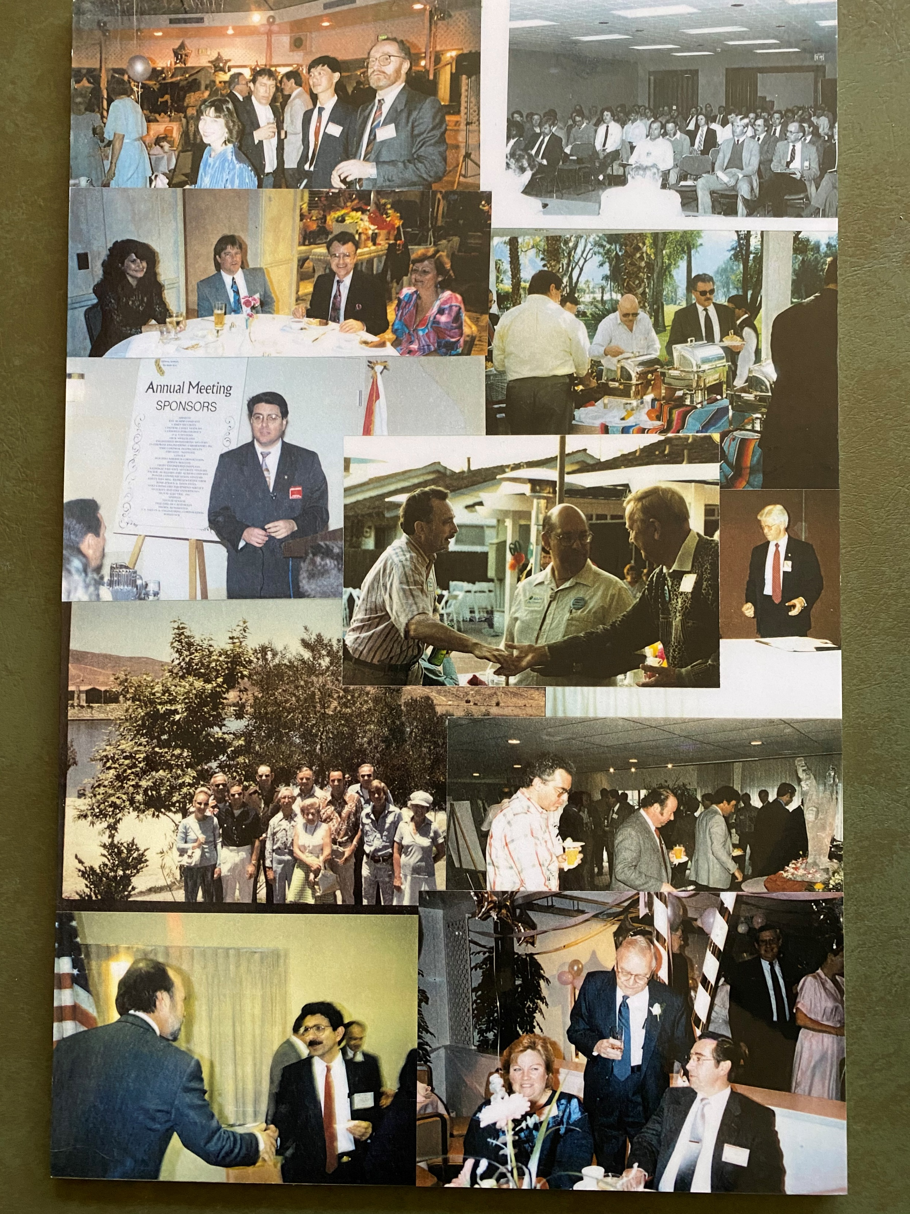

Slide 4
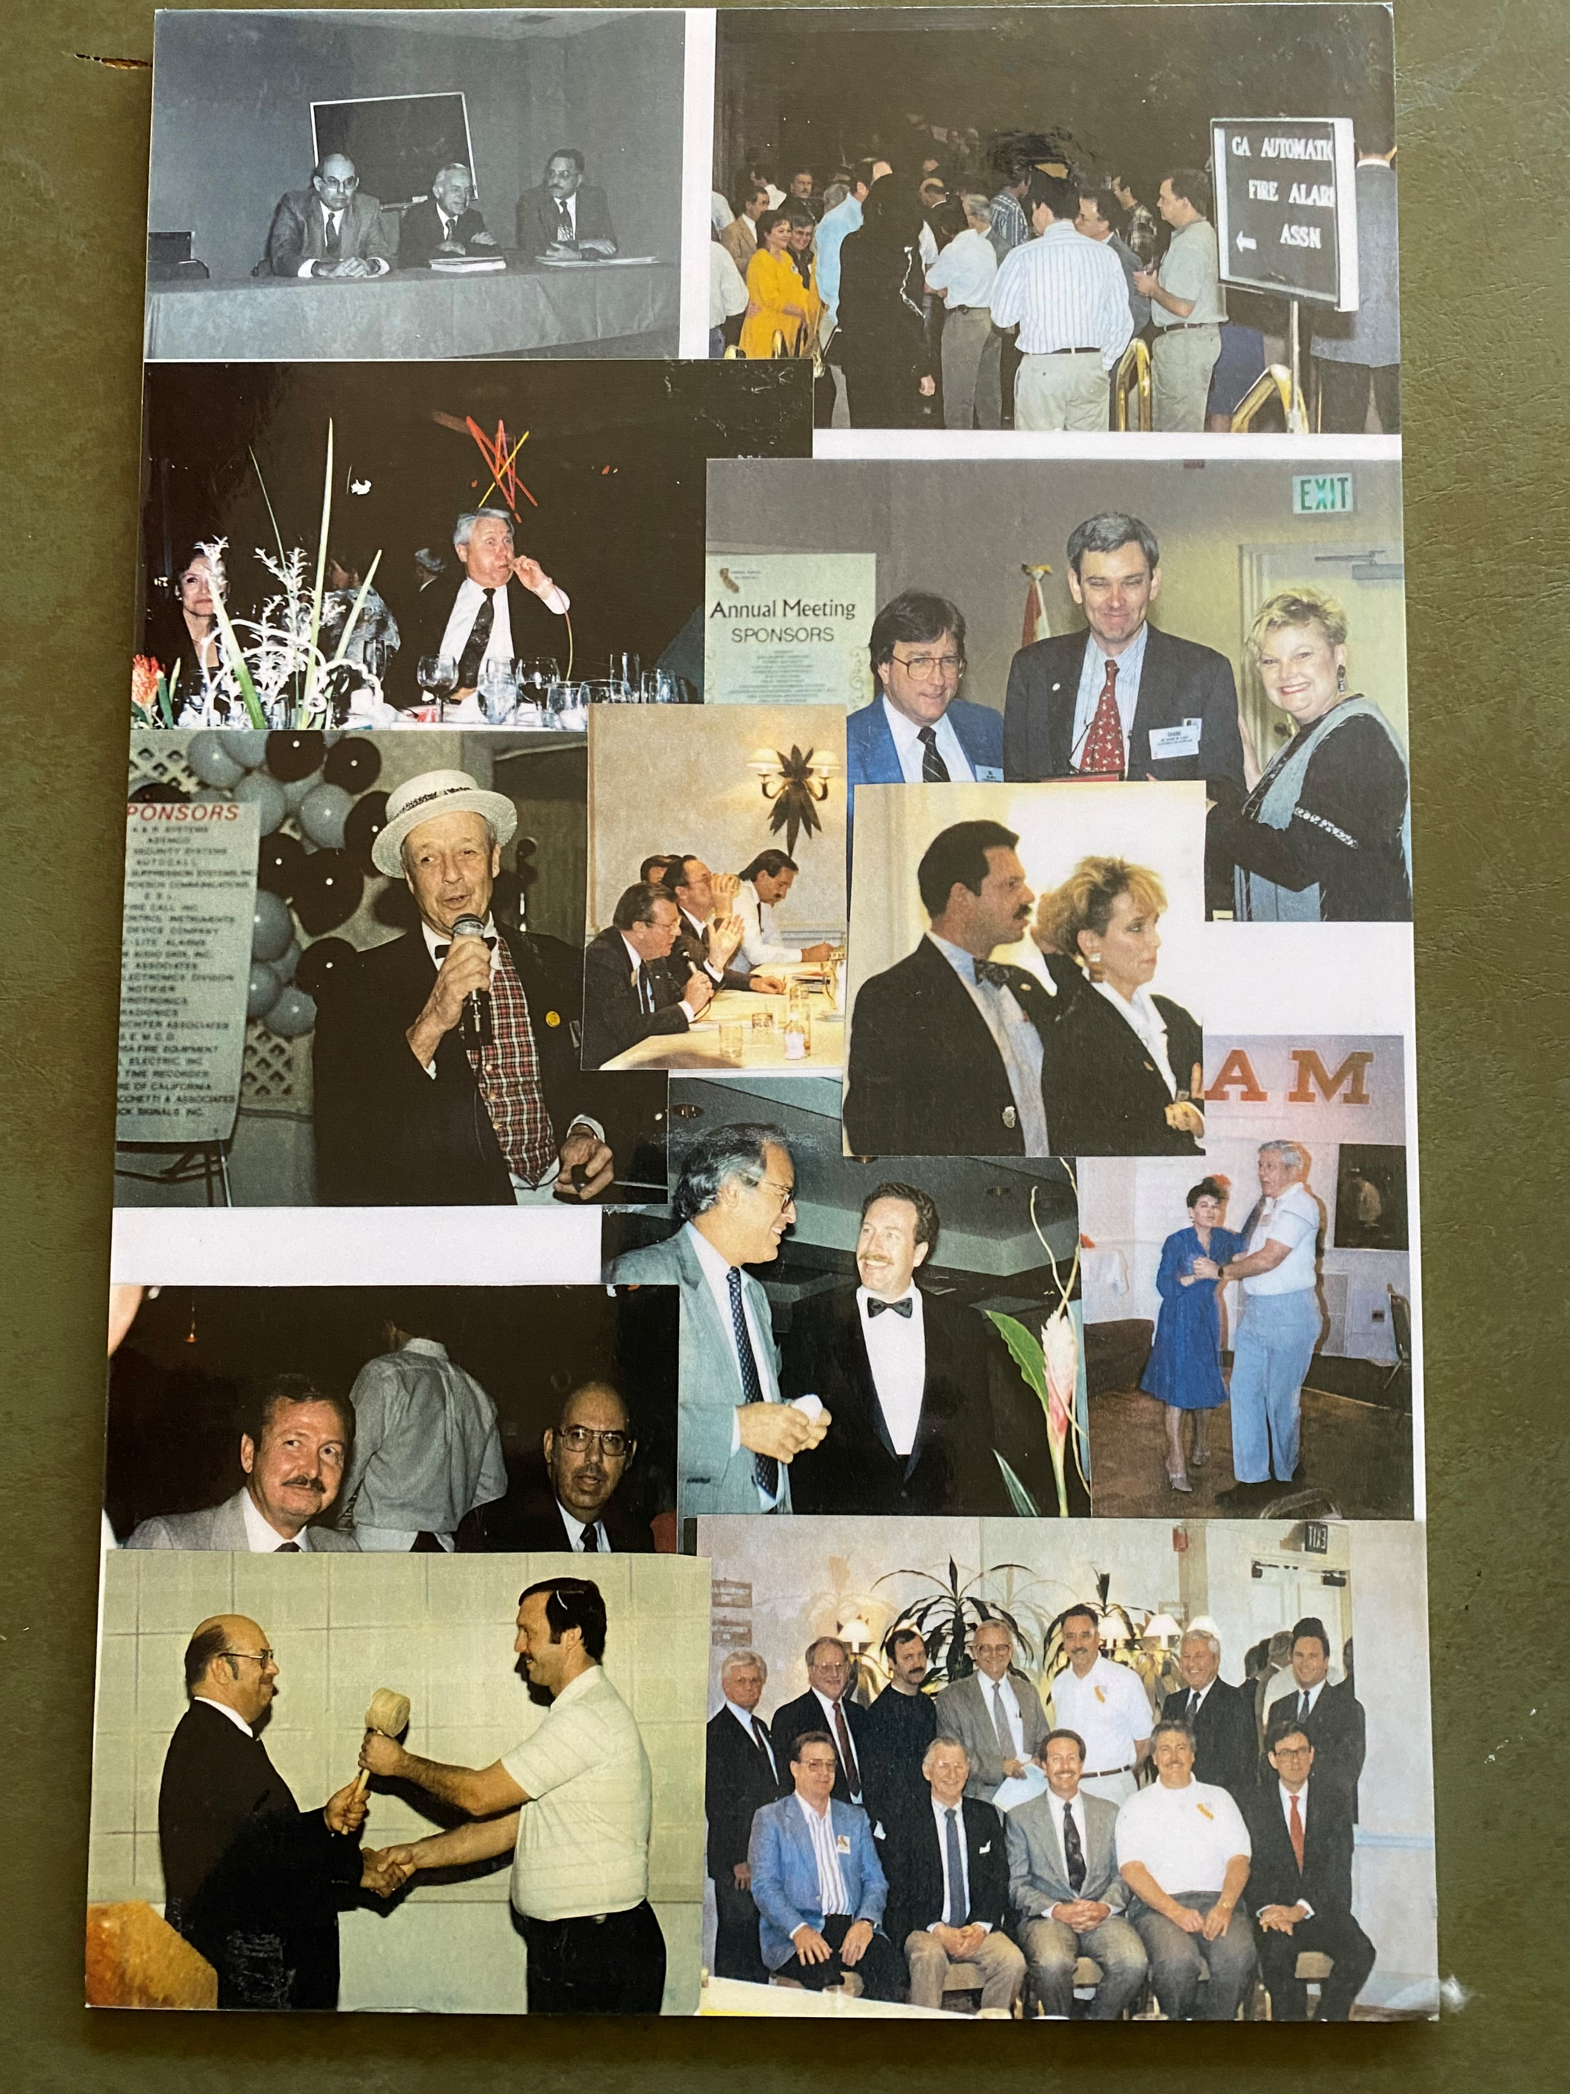

Slide 5
